Slide 1
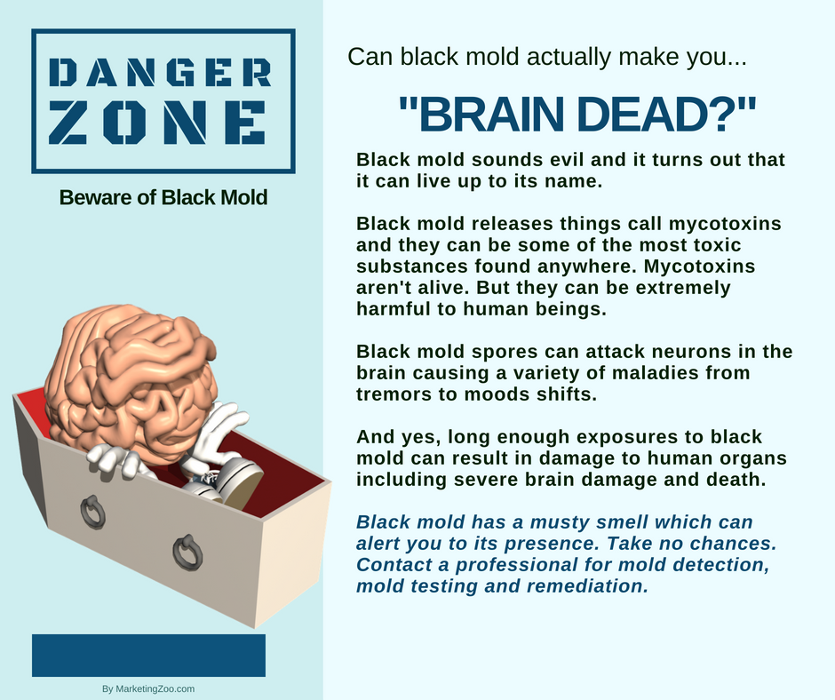
Your Very Own Flood
It can happen. Your own personal flood. In your house.
These events can be devastating, in more ways than one. It’s not just an inconvenience. It’s also damaging to valuable materials, some that just can’t be replaced, and steals much of your time as you clean up after the mess.
When a flood occurs in your home, what’s your natural, spontaneous reaction? Call your insurance agent. That’s what most do. And that’s smart, as you don’t want to spend more time and money on this recovery project than necessary.
But you still have to do your homework. Trusting your insurance company is one thing. Knowing who to hire is another. Remember, it’s your home and your insurance policy. You have some significant input in who is hired to come into your home.
The first thing to consider is being safe. No matter how valuable something is, it’s not as valuable as the health and well-being of your family. Make sure everyone is safe and secure, that the power is turned off in areas affected, such as those with electrical components. But be careful! Just leaving your home and letting the pros go in and take care of everything, scoping out the job, is often recommended.
It’s difficult to do because you want to start looking for valuables and protecting your property. Next is, stand up for your rights. Insurance companies often attempt to limit their exposure and what they will pay. Your typical insurance policy means you have the right to have your home and belongings returned to “pre-loss” condition. Your professional water damage company is on your side. They want to do the work right and they do not want to cut corners.
When a flood happens, it can be an emotional event. Remember, though, if everyone is safe, the “stuff” that is ruined can be replaced.
Do the right thing when your home suffers from any type of water loss. Call your favorite disaster restoration company. After all, it pays to call a pro!
Short & Simple • © 2018 Thinkshortcut Publishing, LLC • Created by MarketingZoo.com

Slide 2
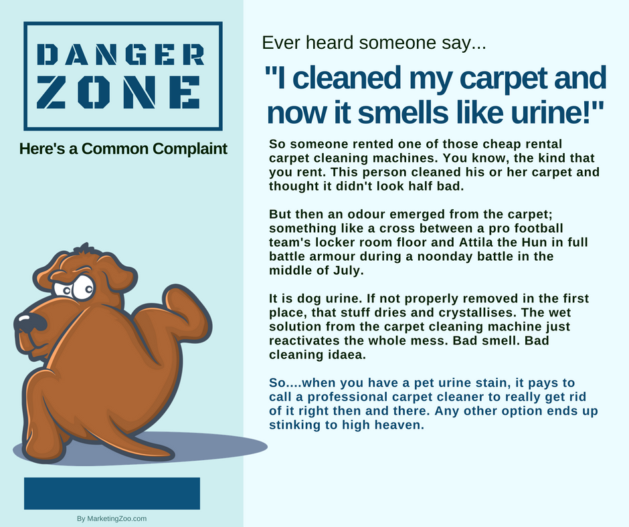
Tile and Grout Floor Care
Tile floors are everywhere, and where there’s tile, there’s also grout. Dirt and grime and other contaminants build up over time and make what was once a beautiful floor look downright ugly. The grout is especially susceptible to soiling and staining.
Just as you would clean any surface, tile and grout floors need special attention. If you keep them clean, following a maintenance schedule, you won’t have to deal with the tough issue of restorative cleaning. Here are a few simple tips for you to follow in order to keep your tile and grout floors in tip-top shape.
Sweep it. The first step is keep the floor swept. Sweep it daily, which will remove dust and debris and other contaminants that can eventually cause tough-to-remove soiling.
Mop it. Tile floors are very easy to clean and maintain. Use a clean mop and an approved detergent to clean the floor. Some prefer the newer flat floor cleaners. Doesn’t matter the tool, it is how you use it and the products you choose.
Some recommend the use of chlorine bleach, which acts as a disinfectant. The challenge here is remaining residues can create issues, such as being tracked off onto carpet, causing color loss. Be careful with the use of any type of bleach.
Grout issues. The toughest part of a tile and grout floor cleaning job is… the grout. It’s porous, even if sealed, and becomes an eyesore quickly.
Purchase a heavy-duty grout cleaner and follow the directions. You will most likely be on your hands and knees, and it takes time to do
this right. Apply the product to the grout, allow some reasonable contact time, and scrub - scrub - scrub! Repeat as necessary. Work carefully until the grout looks great again.
When everything is cleaned up, be sure to rinse with a neutral detergent, or just water, and let air dry and inspect. You will find areas need more attention. When you do… get back to work! Tile and grout cleaning is no easy task, especially when it becomes really soiled. When you find yourself up against an impossible task, do the smart thing. Call your professional cleaning company. After all, it pays to call a pro!
Short & Simple • © 2018 Thinkshortcut Publishing, LLC • Created by MarketingZoo.com

