Slide 1
Appliance Adversities
Water damage issues in your home can really ruin a good day… week… or month.
You want to do all you can to avoid any type of flooding because damage can be quite extensive and expensive. One thing you can do to avoid future issues is to ensure your appliances are in good working order and that they don’t spring a leak that can damage your home.
Obviously, the biggest threat in your home is the toilet. Or toilets, if you have more than one bathroom. They can plug up, overflowing when you flush them. They can also leak at the seal, where the toilet sits on the floor. And, of course, the supply line can leak, sometimes slowly but occasionally with a strong spray of water. This normally happens when you replace the parts inside the toilet tank. Make sure you do a good job when you work on your toilet! You don’t want any surprises popping up.
Second on the list is your washing machine. Its job is to fill up with hot, soapy water, do some shaking, and clean your clothes, and then drain into the sewage system. However, sometimes the drain can become plugged and water can come spewing out, causing all kinds of damage. A hot or cold supply hose can also break, and if you aren’t home when that happens, the damage can be devastating. Be sure to inspect your drain and the condition of your hoses regularly. The seals on the door need to be inspected as well, if it is a front-loading machine.
Third in this lineup of appliances is your dishwasher.
It’s like your washing machine but doesn’t fill up with water quite as much, but if it springs a leak, whether from the drain or from the door, you will have a big mess. Using too much dishwashing detergent can also be a cause of a machine overflowing. Inspect the supply and drain hoses and use the appropriate amount of detergent. The seals on the door, like your front-loading washing machine, need some attention from time to time.
When the worst happens, and your home suffers from any type of flooding, do the right thing. The safest thing. Call your water damage restoration experts.
Short & Simple • © 2017 Thinkshortcut Publishing, LLC • Created by MarketingZoo.com

Slide 2
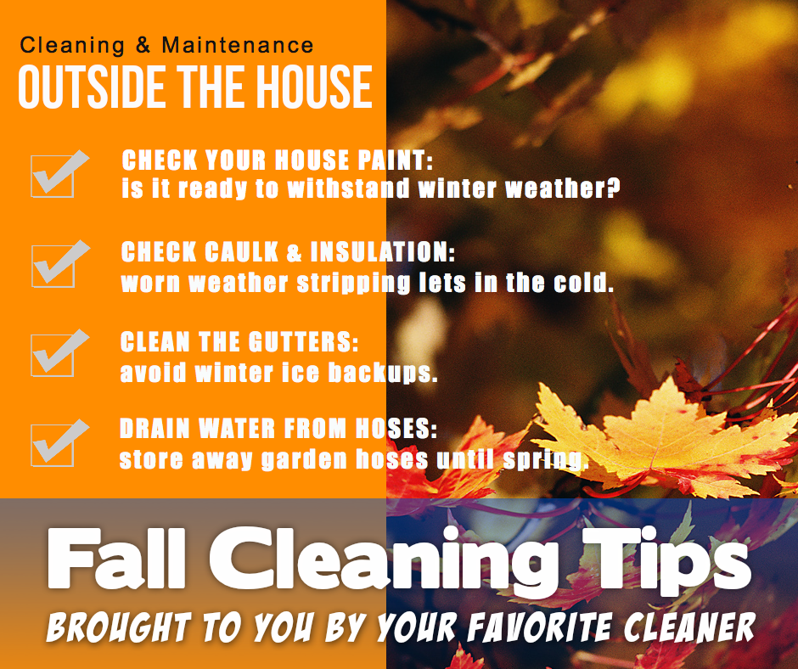
Floor Cleaning Basics
Floors. You can’t avoid walking on them. You can’t avoid looking at them, either.
The condition of your floors really affects the appearance of your entire home. When you have visitors, they notice…whether your floors are clean and tidy and in good condition, and if they are soiled and dirty and in need of repair.
There are all types of flooring in homes today, from carpet and rugs to ceramic tile, luxury vinyl tile, natural stone, wood and more.
It’s generally accepted by most that carpet and rugs are easy to care for, regarding routine maintenance. Regular vacuuming does the trick. As a basic rule, vacuum your heavy-use areas once per week per occupant. Yes, your pets count as occupants. That means if you have a family of five with a dog and a cat, you would vacuum every day. Not the entire house, so don’t panic, but perhaps the living room and any other common-use areas that are trafficked each day. The other rooms can be vacuumed perhaps twice per week.
Ceramic tile is also easy to maintain. It needs swept and mopped frequently to avoid soil build-up. Use neutral cleaners and follow directions. If you notice any streaking after you clean, follow your normal cleaning with a clear water mopping and get it as dry as you can.
Luxury vinyl tile, or LVT, can be cleaned like ceramic tile, but consider a two-bucket system. One with neutral detergent and another with clear water.
Wood flooring is another matter. Be safe and obtain an approved wood cleaning product from the manufacturer, or you can inquire of your favorite cleaning service as to what you should use. After cleaning, you may need to do a light buffing with a soft cloth, especially high traffic areas. Wood is a bit more sensitive than other flooring types, but small surface scratches can often be buffed out. Larger scratches and damage might need to be professional repaired.
There are other flooring types, of course, and each one will respond well to proper cleaning. Floor cleaning can be challenging, as well as hard work. Why not leave it to the pros and spend your valuable time doing something else you enjoy?
Call your professional cleaning service today.
Short & Simple • © 2017 Thinkshortcut Publishing, LLC • Created by MarketingZoo.com

