Slide 1
The Imminent Arrival of Old Man Winter
It may just be the fall season right now, but that’s about to change soon, into… winter.
And getting ready for winter is important, with several aspects regarding your home and protecting what’s most valuable to you. Obviously, winter is outside, but it will want to get inside, and that can cause damage you don’t want.
Window Awareness
If your home is typical, you have a lot of glass — windows, that is. Take a tour, inside and out, and look for areas where the weather stripping is damaged, where there are cracks in the caulking, and gaps where gaps should not be.
When the wind blows, do you hear it coming in the windows, or from around the windows? That’s not so bad right now, but when nasty weather strikes, that’s a different story.
Get your windows in shape now, before winter arrives.
Roof Woes
You can see some of your roof from the ground, but if you get up and take a close look, you may see shingles that need replaced, areas around the chimney or vents that could use some plugging, or other general repairs that are much, much easier
now than when it is zero degrees and icy. But be safe. If you aren’t an expert and able to inspect, hire someone to do it for you!
Gutter Grit
Grit, debris, leaves, and obstacles tossed up there from a windy day can build up. When they do that, and winter strikes with cold, snowy bluster, a plugged up gutter can create really expensive restoration work, because if a gutter can’t drain, this might force melting ice into your home. Get a ladder, take a look. But just like with your roof, only do that if you are an expert. Hire it done if you aren’t.
No matter what you do, occasionally water, wind and ice can damage your home. Do the right thing: Call your disaster restoration pro. After all, it pays to call a pro!
Short & Simple • © 2018 Thinkshortcut Publishing, LLC • Created by MarketingZoo.com

Slide 2
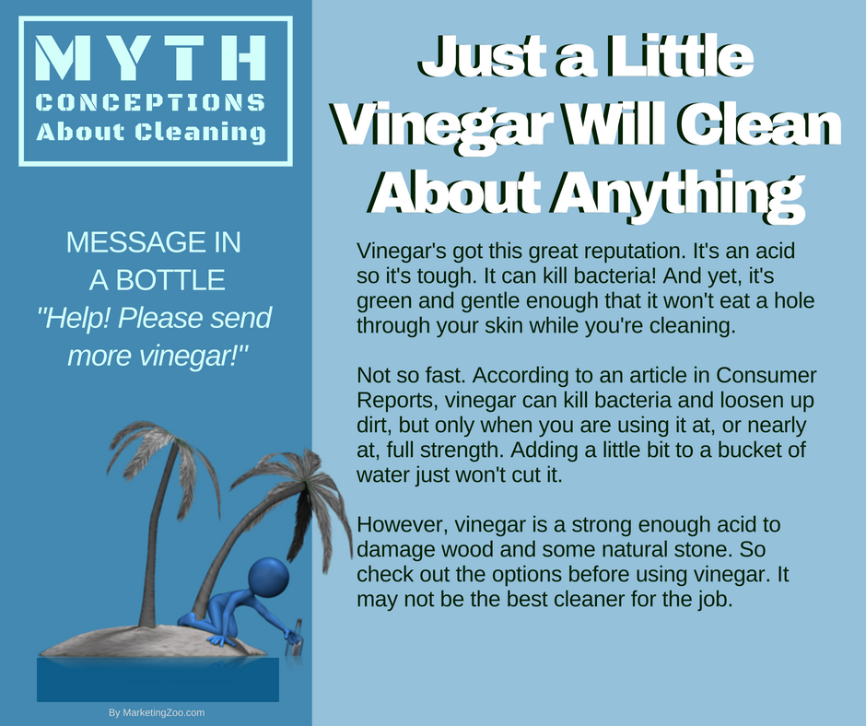
A Clean Kitchen the Easy Way
Here’s an easy quiz for you: What’s the most popular room in your home? If you guessed “the bathroom” you wouldn’t be totally wrong, as it might be the most frequented room in the home.
But hands-down, the kitchen is the most welcoming, most enticing room in your home, because of what happens there. Delicious food preparation, nice conversations, a general gathering place for family and friends.
With that comes much usage and the need for cleaning. To make the unwanted task of cleaning a little easier, here are some simple maintenance tips that will save you time.
Above the floor. The sink, countertops, stove, cabinets and other areas above the floor get heavy use, and the residue can be sticky and challenging to remove.
The most aggressive cleaning is probably in the sink, where grime can build up that isn’t always that apparent. Use cleanser and a sponge or cloth, apply the product and clean multiple times, rinsing often. It should actually squeak when you run your fingers over it.
The other areas should be cleaned with an all-purpose, milder cleanser, misting it on and wiping it off with soft cloths. A final wiping with a cloth with warm water will remove any cleaning residues. You do this every day or so, and you will never notice a buildup of grime or dirt.
The floor. Sweep and mop on a schedule before it looks like it needs it. A dust mop might be OK, but a regular broom with soft bristles often picks up more debris. Hot water and a detergent for the type of flooring you have is recommended, but don’t overdo the concentration as it can leave streaks.
Odds and ends. Something often neglected are the drawers, especially those that hold small items like cooking utensils. Take a look at the drawer that holds your silverware, pull out some forks or spoons, and you will see bits of all kinds of food and debris hiding underneath. Every week, plan on cleaning just one drawer and they will all stay nice and neat.
But when you need a thorough cleaning and don’t want to tackle it yourself, call your professional cleaning company. After all, it pays to call a pro!
Short & Simple • © 2018 Thinkshortcut Publishing, LLC • Created by MarketingZoo.com

