Slide 1
The Battle Against Garbage Can Odors
There’s nothing too exciting about garbage cans, except how you feel if you pull a full trash bag out and it bursts and spews all kinds of undesirables all over the kitchen floor.
If you have garbage, such as limp lettuce, fermenting flounder, greasy goat cheese, and much more, you will have odors from it.
Odors naturally occur from bacteria, which is what grows quickly on organic material. And then you have mold adding to the issue. All this fermenting in a dark, damp playground known as your garbage can.
Even if you have a secure trash can lid, the odors have a mind of their own and an evil intent to escape.
There are several things you can do to limit the effect of garbage can odors.
Take out the trash
It may seem simplistic, but most of us wait too long to take out the trash. A smell garbage can inside is terrible – the one outside waiting to be hauled away isn’t much better, but at least it is outside. Make it a practice to take out the trash before the bag is full.
Use quality scented bags
By quality, we mean bags that have a thicker mil rating, as they won’t break as easy. Yes, they cost more and use more plastic. Look at keeping the mil for your trash bag at 2 or above. The scented bags really do a great job hiding, not removing, odors. They mask bad odors and give you more time between taking out the trash before you start to notice odors.
Use baking soda
Baking soda is a typical household fixture. By sprinkling baking soda in the bottom of your garbage can and even in the bag, it helps to limit the odors caused by bacteria. It does this by absorbing odors instead of them being released into the air you breathe.
Give it a hosing
Like all things, garbage cans need to be cleaned. You might say, “I use bags!” but that doesn’t matter. Odors build up no matter what you do, and a good cleaning with baking soda or other cleaning products, and hosing or rinsing out the can, will help keep lingering odors at bay.
And like all things, quality cleaning of the surfaces in your home are better performed by the pros. Do the right thing, call your favorite cleaning company when you need help. After all, it pays to call a pro!
Short & Simple • © 2019 Thinkshortcut Publishing, LLC • Created by MarketingZoo.com

Slide 2
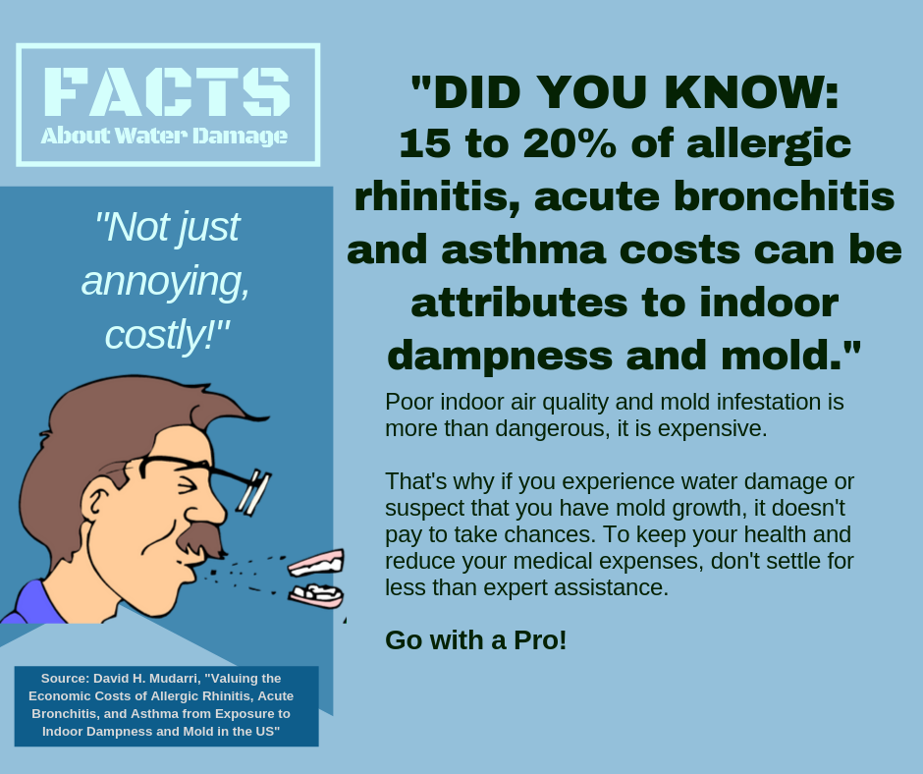
When Insurance Fails
Devastating pipe breaks, failing sump pumps, a smoky kitchen fire, the roof leaking from damage from high winds… no one wants to deal with any of that.
But it does happen, and when it does, you probably do what is natural – you pick up the phone and call your insurance company, most likely your insurance agent, who may direct you to anyone from a central call center to handle your claim, an insurance adjuster, or perhaps to a local disaster restoration contractor they know. And then the fun begins.
You aren’t sure yet if you have coverage, because the insurance company is dragging its feet. The adjuster isn’t able to come out for a few days, something you can’t believe. You worry, fret, and wonder if the damage to your home will be covered, and if you will have to pay for some (or all?) of the damage. You know you have to cover the deductible, and that’s not cheap.
The work begins. Everyone is in a hurry because if the damage isn’t fixed right away, other issues will surface. The restoration contractor does what he is trained to do, and the work progresses nicely, and eventually all is well again at home.
A few days late, the adjuster shows up. And he delivers a devastating blow. While you have coverage, the cost to repair the damage is more than the insurance company feels is fair, so they will only pay a percentage of the costs. The rest? You have to pay for that yourself. What can you do?
One thing is to get another opinion. Hiring an independent insurance adjuster to review the job, all the paperwork, and your insurance policy might shed light on the issue and give you more info you need.
Depending on the new information you receive, you can revisit the issue with your insurance company. Taking this information to the insurance adjuster who you are battling with probably won’t do much good. It’s time to go over his head, as the saying goes. If the difference between the costs of repairs and the offer from the insurance company is high enough, you can also consider a claim to the state entity (such as the insurance commissioner) that has authority and power to help. Many claim to be subject to bad business practices. You might be advised to hire an attorney, all which will cost you more.
The good news is if you hire the very best disaster restoration company, they have the experience to help you deal with all of this. After all, it pays to call a pro!
Short & Simple • © 2019 Thinkshortcut Publishing, LLC • Created by MarketingZoo.com

