Slide 1
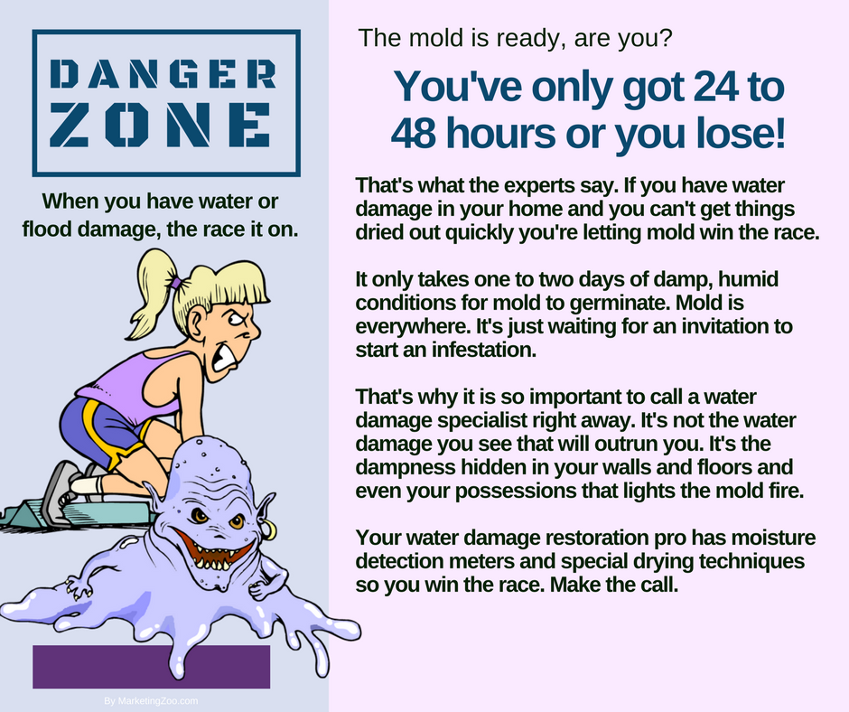
Seasonal Mold Removal
One fact people don’t always appreciate is mold is everywhere. It’s a product of nature, and found inside and outside. When you find it inside, the mold spores can become concentrated, and depending on the severity of allergic reactions, can even be dangerous. That’s why mold contamination in a structure must be remediated by a mold professional.
Mold that is outside your home isn’t much of a danger, unless you or those in your household are prone to allergen exposure associated with mold spores.
If you don’t have allergen issues, then a regular cleaning of the exterior of your home should be a simple task. You have several options you can utilize to accomplish this.
Clean and scrub. The oldest, tried-and-true method of cleaning the exterior of your home from soil, debris, and mold, involves a bucket, brush, sudsing detergent, ladders, and hoses. Using a pump-up sprayer to wet down the exterior means you can get better contact and soak time, and your scrubbing and “elbow grease” efforts are minimized.
Choose a small section at a time. If your cleaning solution dries out, you must re-apply solution and start over. Wash the section, rinse it thoroughly, and allow to dry and then inspect. It may take a couple of cleanings to get the results you want. Any moldy soils that you wash away, make sure you don’t get them on your clothing and bring them inside.
Power washing. This is the most effective, time-saving method of cleaning the exterior of your home and removing mold growth.
You can purchase power washing equipment inexpensively, and you can spend hundreds of dollars as well. The inexpensive version will be electric, and the expensive version powered by gasoline. Either way works well; gas powered versions will be more powerful and faster to use.
As with any surface, apply your detergent and allow it to soak. Then power wash the exterior, washing off soil and mold away from you. Always be safe. Any contact you have with mold, be sure to wash off completely and don’t track it into your home.
Use a pro. Your favorite cleaning and restoration company knows how to tackle this type of chore best. Do the smart thing and save some time and even some money. And headaches as well. Call them up. After all, it pays to call a pro!
Short & Simple • © 2018 Thinkshortcut Publishing, LLC • Created by MarketingZoo.com

Slide 2
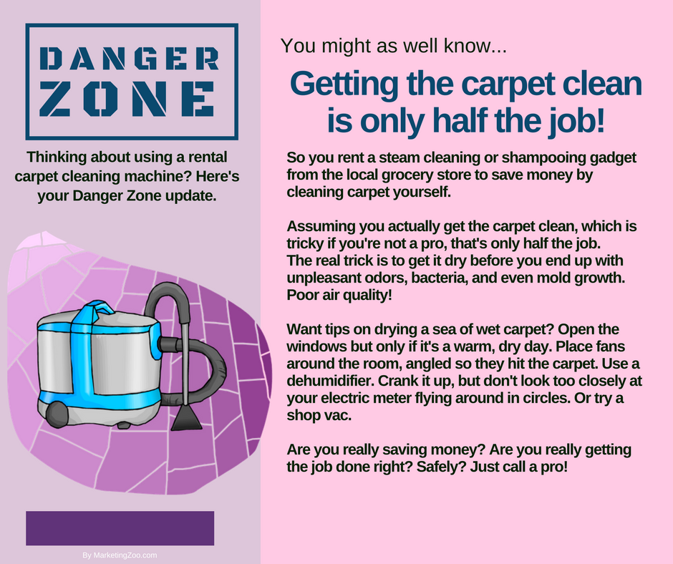
Clean Car Catharsis
So as you stand there looking at your really dirty car, the question that might be on your mind is, “Where do I start?”
Outside. It makes sense to washing the exterior completely, using a sudsing detergent and water. Mix up your solution in a bucket, using warm or hot water if possible, and apply the sudsy mix to the exterior and allow it a few minutes to soak. Then scrub with a soft sponge or cloth, and rinse. If your water is hard, you’ll need to hand dry after washing.
The toughest part of cleaning the exterior of often the front of the vehicle, such as the bumper. Bugs, road tar, and other debris can build up and be really challenging to remove. Use your cloth vigorously, along with some dry solvent solution for the tar, but be very careful not to rub too hard or use too strong a solvent as that can damage paint. When the car is clean, consider a wax treatment, following manufacturer directions.
The tires need some special attention. A dish-washing sponge with a handle is a good tool to get in tight areas in wheel hubcaps and other sections of the tire. Following cleaning, you can use a tire shine product to really make your car look sharp.
Inside. This is where cleaning gets rough. All those details in the car need cleaned. That’s why they call it “automobile detailing” after all.
Start off with a thorough vacuuming of everything. The seats, carpet, nooks and crannies, under seats, between seats. You get the picture. A lot of stuff will be in there, and a vacuum with a crevice tool is the best way to reach debris.
Lay out your car mats and vacuuming them with an upright vacuum, as that will break free and remove more dust.
Mix up a sudsing detergent solution in a bucket, and using soft cloths, begin to clean all hard surfaces. You will need dry cloths as well, as you work through the vehicle. Some cotton swabs will work for reaching in smaller areas, such as air vents.
After all that is done, it’s time to do the windows. Use lint-free cloths and window cleaner, and inspect with a flashlight to see if there are any streaks remaining.
There’s more you can do, obviously, such as shampooing the fabric and cleaning any leather you may have. But these basic steps will get you started on your pathway to clean car catharsis. And remember, your favorite cleaning company knows all about how to clean any surface, including your car. Call them today. After all, if pays to call a pro!
Short & Simple • © 2018 Thinkshortcut Publishing, LLC • Created by MarketingZoo.com

