Slide 1
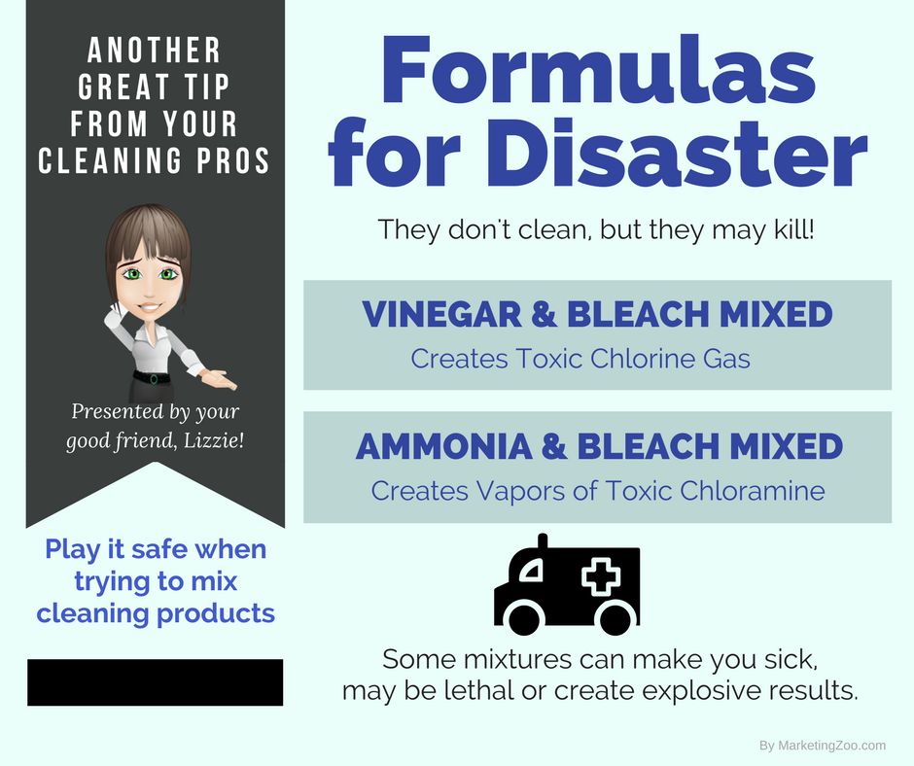
Clogged Drain Dramas
It sits in the center of every sink, at the end of every bathtub, and could be anywhere at the bottom of a shower stall… that’s right. You see them all the time. Drains that faithfully work to take away soapy water, food waste and more.
So when they slow down or even quit working entirely, it is very frustrating and annoying.
Your first inclination is to grab a plunger, which might work but more than often… it doesn’t work at all. But you have to try! Sometimes, a connecting drain to the plugged one allows air to escape and the plunging action is worthless. You can plug the second drain with a towel or cloth, and that might help with the plunging action.
If typical plunging doesn’t work, consider these steps to enable a drain to do what it’s supposed to do.
Step 1: The drain could be plugged with something that could be melted, dissolved or moved by super-hot water. Boil an entire pot of water and (very carefully so you don’t get burned) pour it into the drain. It might be enough to clear the drain.
Step 2: Often, protein matter, such as hair, plugs up drains, especially in sinks, tubs and showers in bathrooms. Carefully pouring chlorine bleach into the drain, enough to fill the drain, and then allow the solution to
work on the hair will work. Chlorine bleach is very inexpensive but very powerful. It will eat its way through a drain blocked with hair and clear it out so it drains effectively.
Step 3: It’s time to get physical. Unclogging a drain with an auger, also known as a “snake” will move what’s stuck. You can purchase a tool like this at your local hardware store. Carefully insert the end of the snake into the drain and push and pull until you move the blockage or can pull it out. You can do this from the drain itself or from the pipe below if accessible.
Sometimes a clogged drain creates a big mess. When that happens, and for all your cleaning needs, call your cleaning pros for help.
Short & Simple • © 2017 Thinkshortcut Publishing, LLC • Created by MarketingZoo.com

Slide 2
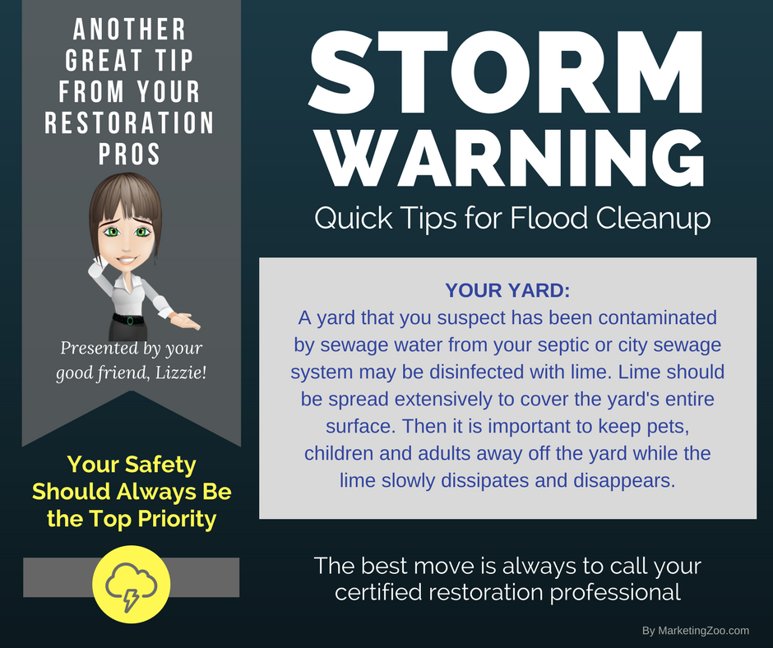
The True Value of a Restoration Company
When a fire, flood, water leak, mold growth or other issue that makes your home either inhabitable or just an inconvenience to deal with, you must decide “Will I clean this up myself, or hire a pro?”
While some small, minor “disasters” can be tackled by a do-it-yourselfer, most restoration projects are best left to the pros.
Here’s why.
Safety: Obviously, keeping your family and loved ones safe is important to you. When dealing with disaster issues, what might seem like a minor issue may actually be a dangerous situation. Water damage, even from the smallest leaks, can result in mold growth. Wet materials that might seem to be drying out could hold moisture in hidden areas. Smoke from a fire can be dangerous as well.
Back to normal: Anyone that has never suffered from a loss might not understand the emotions, frustrations and feeling of hopelessness that are common during a restoration project. Using a professional company means things move along quickly, and you are back in your home or able to use damaged rooms as soon as possible. Doing it yourself can make the project drag on for days longer than necessary, often with undesirable results.
Insurance coverage: Water, fire, smoke, wind, mold… what’s covered? And what’s not? Insurance policies are difficult to interpret, yet a professional disaster restoration company works with insurance companies every day, so they are best equipped to help you through the process of dealing with insurance agents and adjusters. You want to be treated fairly and receive fair coverage from your insurance company. Having a qualified, reputable restoration contractor in your corner helps with the entire process.
Do what’s right. Call your disaster restoration company when you suffer any type of loss.
Short & Simple • © 2017 Thinkshortcut Publishing, LLC • Created by MarketingZoo.com

