Slide 1
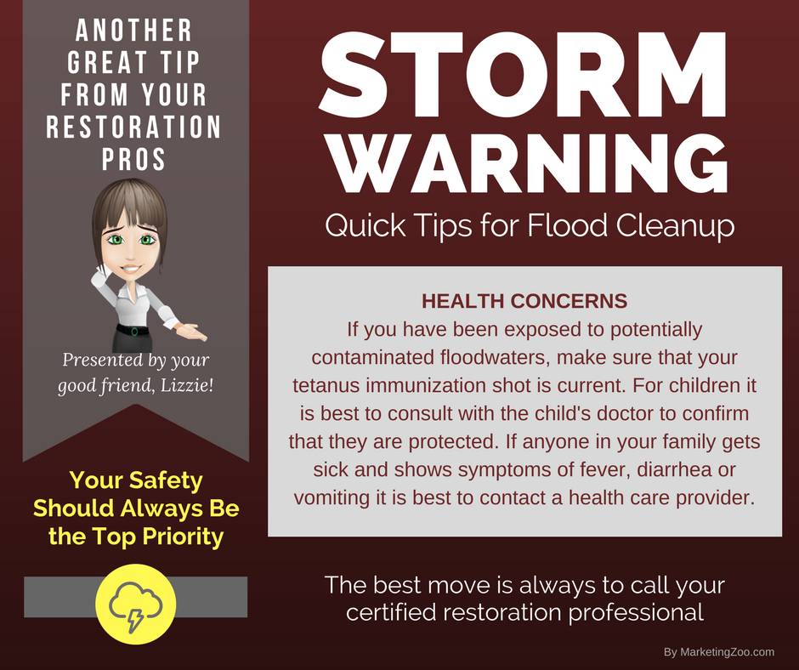
Create Your ‘Go Bag’
Floods, fires, high wind and other damaging events caused by inclement weather can happen anywhere, anytime and to anyone.
Thinking and planning ahead can give you peace of mind.
One great way to plan ahead is to create an emergency preparedness kit, or as some call it, a go bag, which is a backpack, small suitcase or other container packed with essential items you might need in an emergency, especially if you are evacuated from your home.
While it is true odds are in your favor that you may never have to evacuate your home or relocate on a temporary basis, when it does happen, your basic needs will be cared for if you have a go bag ready to… go.
When you build your own go bag, remember that one size does not fit all. In other words, there is no perfect list for you or your family, just suggestions. You must base your own go bag contents on what you need. What should your go bag include? Several essential items, such as:
Bottles of water
Non-perishable foods
Flashlight with spare batteries
First-aid kit
Necessary medications
Personal hygiene items
Warm clothing
Emergency cash
Copies of important papers
Any essential pet care items, such as food and leashes
Don’t forget other items that may not be considered if you are in a rush, such as cell phone chargers for your mobile phones, extra keys to your home
When you compile your food items, think protein… such as in protein bars, nuts, beef jerky, just to list a few. When you visit your local grocery store you will be surprised how many options you have available to you.
Some people even include battery-operated radios, whistles, pocket knives and multi-tools, butane lighters, dust masks, maps, notebook and pen or pencil, extra eyeglasses and more. When disaster strikes, don’t forget you have some expert help and advice from your restoration pros. They will be there to help you restore or rebuild what you have lost. Give them a call.
Short & Simple • © 2017 Thinkshortcut Publishing, LLC • Created by MarketingZoo.com

Slide 2
Removing Deodorant Stains
It can be very embarrassing, especially if it happens at a business meeting or social event. When it does happen, you may wish you could crawl into a hole.
What are we talking about? When you raise your arm for something and show off an unsightly deodorant stain on your shirt, blouse or other item of clothing. You know people notice because their eyes are drawn right to your armpit, and there is never a hole close enough to crawl in to.
This type of stain builds up over time. When you perspire, some of the deodorant transfers to your clothing and each time you do the laundry, some of it sticks. However, removing deodorant stains can be accomplished with a few simple steps.
Plan ahead: Before putting your clothes in the laundry basket, spray or rub areas of concern liberally with a product designed for treating laundry spots and stains. Your regular laundering will be much more effective.
Pre-treatments: Before laundering the offending garments, fill a sink or, if you have a lot of clothes, a bathtub with hot water and add a small scoop of laundry detergent and mix it up until completely dissolved. Put the clothes in and let them soak for 30 minutes, and then launder them right away.
Color-safe bleaches: As you would do with pre-treating in a sink or tub, instead of using laundry detergent, add a scoop or two of a
color-safe bleach, best known as OxyClean at your grocery store. Follow directions on the package and allow plenty of dwell time for this oxidizing bleach to work.
Chlorine bleach: This is a last-resort attempt to remove deodorant stains. Chlorine bleach, such as found under the name “Clorox” at your grocery store, is an oxidizer but very aggressive. Use with care. Follow directions on the bottle when you use this type of product either as a pre-treatment or in the washing machine.
And when you need something cleaned you can’t do yourself, such as your carpet, tile and grout, furniture or other surfaces, don’t forget to call your cleaning pros. They know how to do it right!
Short & Simple • © 2017 Thinkshortcut Publishing, LLC • Created by MarketingZoo.com

