Slide 1
Mold Facts For Everyone
Mold is everywhere and is necessary for life. But too much of it — and especially if what is considered by many a harmful variety — can be hazardous to the health of many. Not everyone is sensitive to exposure to mold. Some people can be around it and have no side effects at all. Others have allergic reactions, asthma symptoms, and various respiratory issues. The absolute best defense to mold exposure is to keep as much of it out of the home in the first place. There is no way to eliminate all molds, but some practical mold prevention steps are necessary to a healthy home. Controlling moisture is the primary goal to minimizing mold growth. Mold is a live organism and needs moisture to grow and spread. If you reduce moisture in the home, you take away the food source of mold. For many homes, this means concentrating on the basement. Water seepage into basements is a common cause of mold growth. From expensive steps such as hiring a company to seal off basement walls, to inexpensive steps such as running a household dehumidifier — whatever you decide to do is going to help any moisture situation.
Venting bathrooms, laundry rooms, and other moisture-generating areas of the home is also smart. Physically removing air laden with moisture means mold growth is limited.
Running the air conditioner during humid periods of the year keeps the humidity content lower in the entire home. Yes, it costs to run the AC, but it will cost you more if you have a mold problem and need professional remediation. Keep an eye on areas that suffer from condensation, such as windows, doors, even pipes under sinks. Condensation is an excellent source of moisture that mold will use to grow. Remember, mold can be found almost anywhere, and can grow on virtually any surface, such as wood, paper, and dirty carpet (mold usually does not grow on clean carpet). If you discover moisture intrusion issues, such as from a leaky pipe, drain, toilet, or in the basement — anywhere in the home — take steps to fix the issue. And be sure to inspect for mold growth. If you see any evidence at all, do the right thing. Call your professional water damage company right away. After all, it pays to call a pro!
Short & Simple • © 2018 Thinkshortcut Publishing, LLC • Created by MarketingZoo.com

Slide 2
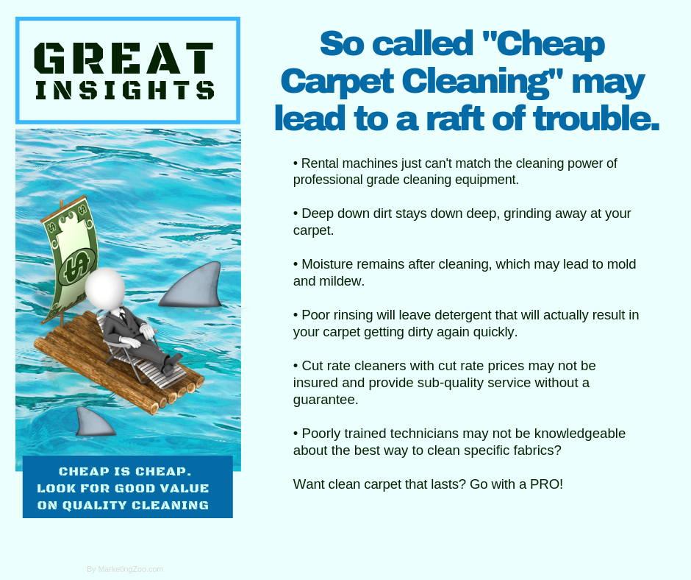
The Dreaded Litter Box
It’s part of the home that you try to hide. It’s one that you hope no one stumbles across and, of course, hope no one sniffs and notices it is there. If you have cats, you know exactly what we are talking about. If you have cats, you either train them to go outside (unlikely) or use the toilet (as seen on YouTube) — but most resort to the standard litter box for their feline friends to do their “business.” As much as you would like anyone else but you to take care of cleaning and maintaining the litter box, if you are the owner of the cat, it’s probably your job to do. Here are some simple tips to do it faster — and better — and keep things a little more sanitary as well. Keep it contained. One thing most hate is when the cat (or cats) leave the litter box and bring those tiny litter particles with them, tracking them all over the home. Placing a cat litter mat under the cat box and some type of carpet remnant where the cats step out on helps reduce the amount of litter tracked through the home. Protect yourself. Litter boxes are festering tubs of bacteria and other contaminants that need to stay right there in the box.
But a cleaning must happen, usually every day, to keep the clumps from taking over and becoming difficult to scoop. Wear a proper pair of gloves, and even a dust mask, to keep yourself healthy and safe when doing the scoopin’. Fresh is best. Besides daily scooping, adding some litter every few days is smart. When the litter gets low, add a little more to keep the litter box sufficiently full so your cats can easily cover over their “deposits”. You don’t want to give them any excuse to skip the litter box for a more convenience area to use, if you know what we mean. And each month, empty and completely wash the pan, and add fresh litter. The inevitable. One thing that cats may do from time to time is “miss” the litter box, creating nasty odors, especially in carpet. That’s when you need some real help, from your favorite cleaning service. Do the right thing. Give them a call today. After all, it pays to call a pro!
Short & Simple • © 2019 Thinkshortcut Publishing, LLC • Created by MarketingZoo.com

