Slide 1
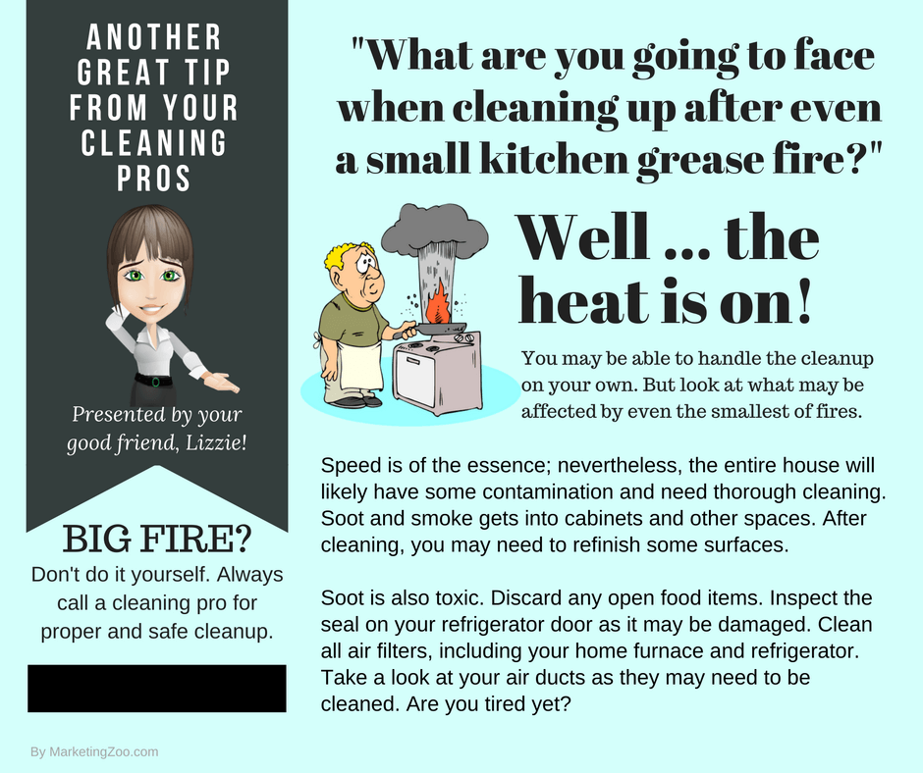
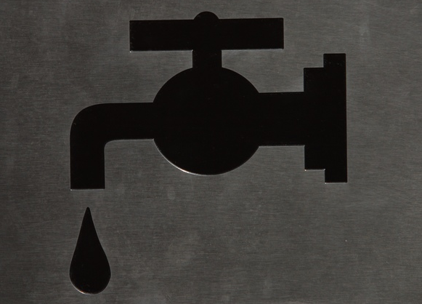
Dripping Your Way to Trouble
Drip… Drip… Drip… a leaky pipe or drain may not seem to be that big of a deal, but it could be the first indicator of big trouble coming your way.
Most people — just like you — think of water damage situations as a broken pipe spewing water all over the place, or perhaps a failing sump pump resulting in a basement that imitates a swimming pool you did not want.
Other water damages can occur from an overflowing toilet or — even worse — sewage backup that can mean replacement of surfaces and belongings in your home.
Catastrophic water damage situations, such as from a storm, flood waters and similar water intrusions, are about impossible to predict and prepare for.
But when it comes to smaller issues, you can do quite a bit to keep your home nice and dry and free of musty, moldy odors.
The first step is prevention. If you have a faucet dripping, you may think the only loss would be pennies a day. But what if your drain plugged up and you were gone for an extended period of time? Drips can quickly add up and create an overflow that can cause expensive water damage. And a leaky pipe under a cabinet or toilet is really bad news as that can quickly get worse and flood your home. So be sure to either fix these issues yourself or hire a plumber.
The second step is to dry out any existing moisture that may exist in areas that can be damp from either dripping water supply pipes and hoses to drains. Wipe up as much water as you can and get some air movement onto the surfaces affected.
The third step is to get professional help. Call your water damage pro not only when emergencies strike, but to receive valuable advice in advance.
Do what’s right. Call your water damage pro!
Short & Simple • © 2017 Thinkshortcut Publishing, LLC • Created by MarketingZoo.com

Slide 2
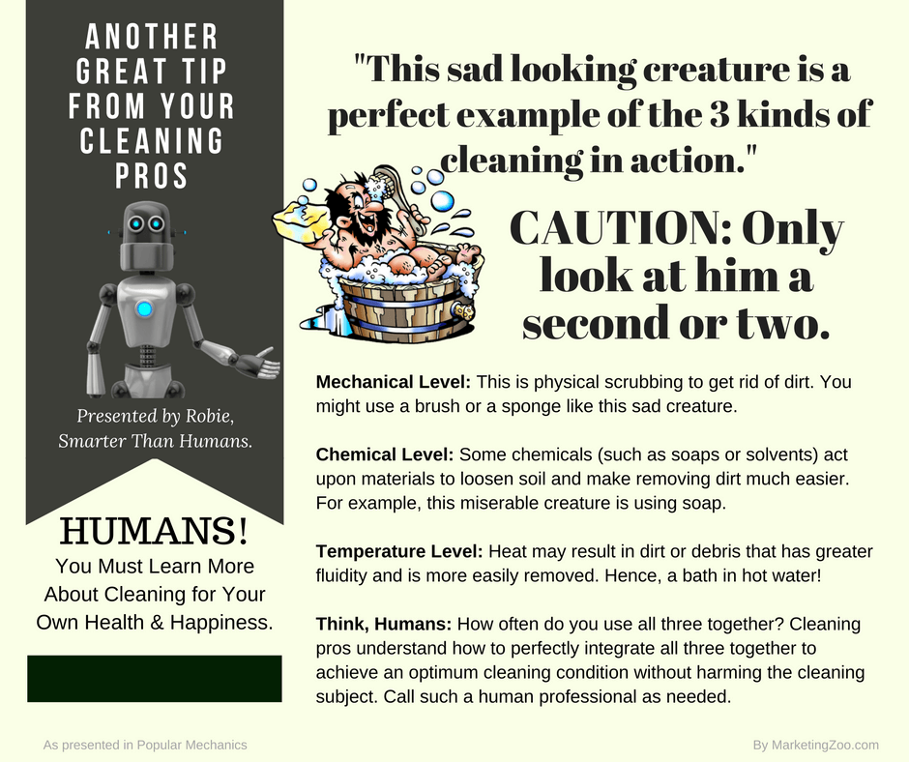
Mattress Matters
Thinking about the care and cleaning of a mattress may not be on everyone’s minds, but when you consider you spend six, eight or even more hours with it every day… you should take good care of it.
Some people notice that over time, perhaps just a year or two, they suffer more from allergies and other conditions. It is possible an unclean mattress could be the culprit.
This is not saying there are issues with anyone’s hygiene. Mattresses are like any other surface and they need regular cleaning — yet when you cover them up with clean sheets on a regular basis, not many give it much thought.
Dust mites (which are in every bed), their fecal matter, dead skin cells and more all add up over time and can cause a host of health issues.
There are many steps you can take to keep your mattress clean and healthy.
Here are a few:
Change the bedding on a regular basis
Use a mattress cover to keep contaminants out of the mattress
Vacuum the top of your mattress, perhaps four times a year
After vacuuming, flip the mattress and vacuum again
Those are pretty basic steps, but ask yourself… “Am I doing them?”
If not, start now. You will have a healthier sleeping environment that not only gives you peace of mind, but also relief from some allergic reactions and other issues that you may have been suffering from but didn’t know the source.
Don’t forget, there are professional service companies that can periodically give your mattress a deep cleaning. Just as with all your carpet cleaning and furniture cleaning needs, call your favorite professional cleaning company to care for your mattress.
And then you can do what everyone wants: Get a good night’s sleep!
Short & Simple • © 2017 Thinkshortcut Publishing, LLC • Created by MarketingZoo.com

