Slide 1
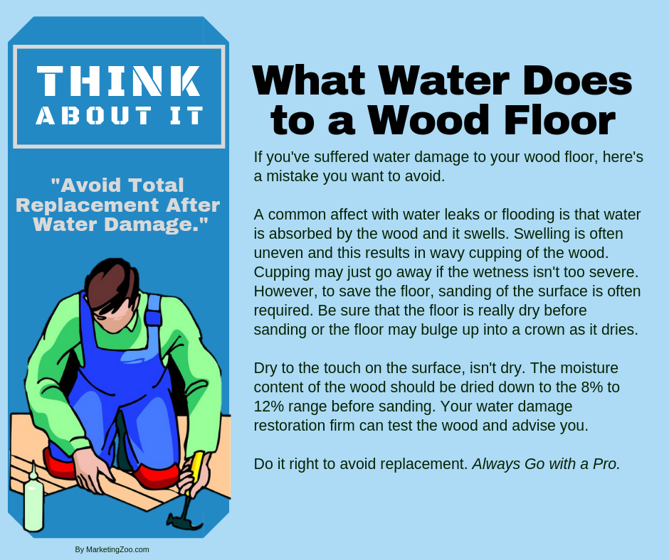
Disaster Assistance
When something happens to your home, something that damages it, you have one thought in mind: What you can do to fix it and repair it so you can get on with your lives.
Damage can come from many sources. It can be a tree falling onto your roof. It can be water seeping into the basement. It can be water gushing from a broken pipe. It can be from a failed sump pump. It can even be more catastrophic, such as from high winds or even a hurricane, if you live in parts of the country that are subject to those types of storms.
When any of these issues occur, someone has to pay for the repairs. That’s where professional disaster restoration companies come to the rescue. They have the know-how and expert skills to fix any issues that arise from disaster restoration situations.
But again… someone has to pay…
You might be thinking that your homeowner’s insurance plan will cover any disasters that might occur. The typical insurance plan does cover most issues — but not all. Some of them do not cover specific types of flooding situations. If a pipe outside your home, such as an outside spigot, were to break and flood your home, that may not be covered. Every policy is somewhat different.
It’s smart — in advance — to discuss with your insurance agent about what is covered and what is not, and to get a handle on your deductible, as you are responsible for that in the event of a loss.
When insurance fails…
Unless you have a pretty healthy balance in your checking account, you may be looking for some assistance if your homeowner’s policy comes up short. Besides the obvious use of credit cards to pay for work on your home, there is government assistance you can use for help.
The U.S. Small Business Administration is the answer for many people. And not just those who own businesses. The SBA has money to loan to homeowners as well, those who find themselves in a situation where they need money to do necessary and significant repairs to their homes. The SBA has disaster loan application forms online that you can find with a simple online search.
As with all disaster restoration situations, it’s always smart to get the best help available. Do the right thing and call your favorite disaster restoration company. After all, it pays to call a pro!
Short & Simple • © 2019 Thinkshortcut Publishing, LLC • Created by MarketingZoo.com

Slide 2
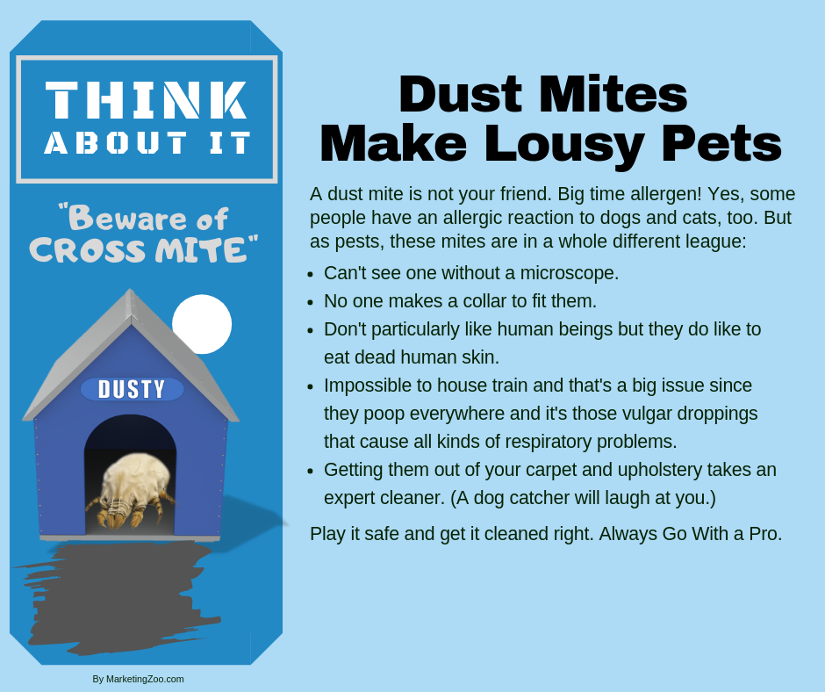
How to Protect Your Tile Floors
No doubt in your home you have both carpet and hard floors, and probably a good bit of tile flooring.
Tile floors are great because they are fairly easy to maintain, and if something is spilled, easy to clean. Some homeowners prefer tiles floors over other types because of their durability and longevity. While soft surfaces like carpet tend to show wear areas in just a few short years, tile floors are quite durable.
Mistaken assumptions
Tile floors, while easy to clean with simple cleaning steps, such as sweeping and mopping, are still subject to issues that take a little extra thought and effort when it comes to maintenance.
One issue many have is with any grout lines in the floor. While tile is fairly non-porous, the grout is not. Light-colored grout lines can soak up spills and staining substances and be very difficult to clean.
One way to prevent this from happening — although nothing is 100% foolproof — is to protect the grout. You can do this with a quality protective sealant, which you can obtain from the same store you purchased your tile flooring. Most big box stores carry quality grout protectant products. The time to apply this is when the tile floors are new or after they have been thoroughly cleaned, preferably by a professional cleaning service.
With proper application of a quality grout sealant product, you have time to clean up spills before they soak in and stain the grout.
Physical damage
Everyone moves things around, such as their appliances, especially when it is time to do a thorough cleaning. When that happens, your tile floors are in danger!
Sliding a heavy refrigerator or range can scratch and scrape tile floors, leaving unsightly marks. Unless the feet of your appliances are soft, such as coated with rubber, this is something to be aware of.
When moving heavy appliances on tile floors, putting small squares of carpet — upside down — under the front legs will keep damage from happening. Then, as the appliance is pulled out, put squares of carpet under the back legs. If the squares of carpet aren’t visible just leave them there and you won’t have to worry about this issue in the future.
As with any flooring issues you have, from tile floors to carpet, call your favorite cleaning company. After all, it pays to call a pro!
Short & Simple • © 2019 Thinkshortcut Publishing, LLC • Created by MarketingZoo.com

