Slide 1
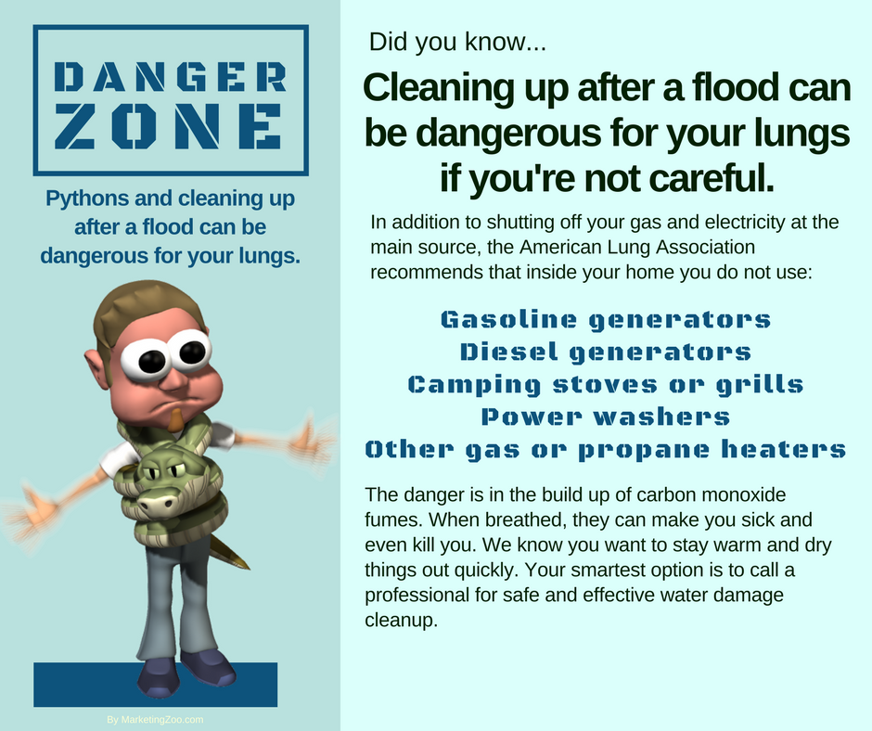
Electricity Exposed!
For most homeowners, and even those working in commercial buildings, the number of appliances that use electricity is mind-boggling. With that comes the issue of safety. After all, if you have a dozen (or more!) items all humming with power in your home, odds are that eventually there could be an issue with electrical safety.
Don’t let that happen to you. Give these practical, household appliance tips some consideration to keep your family and loved ones safe while enjoying the benefits of anything powered by electricity. Although electricity can become exposed, you don’t want that! Smoke, fire, and other damage can occur.
Appliance safety
An “appliance” doesn’t have to be a stove or refrigerator. The term can refer to smaller items, such as space heaters. All appliances that use electricity generate some type of heat and can become unsafe if electrical connections become loose or damaged. That can happen with normal wear and tear and age of the appliance. Even gas appliances, such as an oven or stove, most likely use electricity to ignite the flame, or even keep track of the time of day.
The job of certain types of appliances is to generate heat, and a lot of it, which automatically elevates the safety concern in the home. These can be toasters, toaster ovens, regular ovens and stovetops, space
heaters, clothes and hair curling irons, hair dryers and more. The list can be extensive. Make sure, when applicable, there is plenty of space from anything that generates heat and anything that can ignite. Many homes have suffered fire and smoke damage because someone set down a clothes iron on something ignitable or the toaster was too close to the side of the refrigerator and papers attached to it caught on fire.
We all know this, as well: When there is electricity and water, shock hazards can occur, along with possible fire ignition. Analyze each appliance and make sure they aren’t too close to any water source.
Next month, we’ll discuss another appliance safety feature that you might be wondering about… power cords!
And remember, if anything does happen in your home, whether it is a fire and smoke damage situation or flooded basement, do the best thing to bring conditions back to normal. Call your favorite disaster restoration company. After all, it pays to call a pro!
Short & Simple • © 2018 Thinkshortcut Publishing, LLC • Created by MarketingZoo.com

Slide 2
Hazardous Waste
Most items we toss into the trash can are supposed to go there. Normal debris, paper items, leftover foods, among others. You know what we mean. Items like that paper filter full of coffee grounds that you just tossed a few minutes ago.
However, there are some items that shouldn’t automatically go into the trash can. Things that can contribute to the global issue of “hazardous waste.” No, not the nuclear or radioactive type. The hazardous waste that we all generate and should dispose of properly.
Common items that fall into this category are found throughout your home… in basements, under kitchen sinks, in the garage, in closets, and other places. These items can include cleaning products, paints, varnishes, automotive fluids, pesticides, batteries… even electronic items such as old computers that haven’t worked for years. A quick internet search shows a huge list of potential items you might toss in the trash can but should give second thought to doing so.
Some leftover household products that can be considered hazardous waste contain corrosive, toxic, flammable or other reactive elements. You might have, in the past, just thrown them away, to get rid of them. That’s human nature. You figure the disposal company knows what to do. You are right. But they don’t know what’s in the bags you set out. This means you can help by being a smart consumer. Before throwing away items that could be
potentially hazardous, think about how you can determine the best way of disposal. One way is to review labels on items you are throwing away.
They should indicate the type of danger they pose and might even have disposal instructions. If the item recommends you wear gloves or eye protection, that’s a clue it could be hazardous waste. Another option is to ask your waste disposal or recycling company for instructions or perhaps contact information for appropriate local government agencies that can provide you with detailed information not only on what is common hazardous waste, but also on local disposal options, including locations you can use to take hazardous waste materials.
One thing you can be sure of. Your favorite cleaning company uses only safe, effective cleaning products when in your home. After all, it pays to call a pro!
Short & Simple • © 2018 Thinkshortcut Publishing, LLC • Created by MarketingZoo.com

