Slide 1
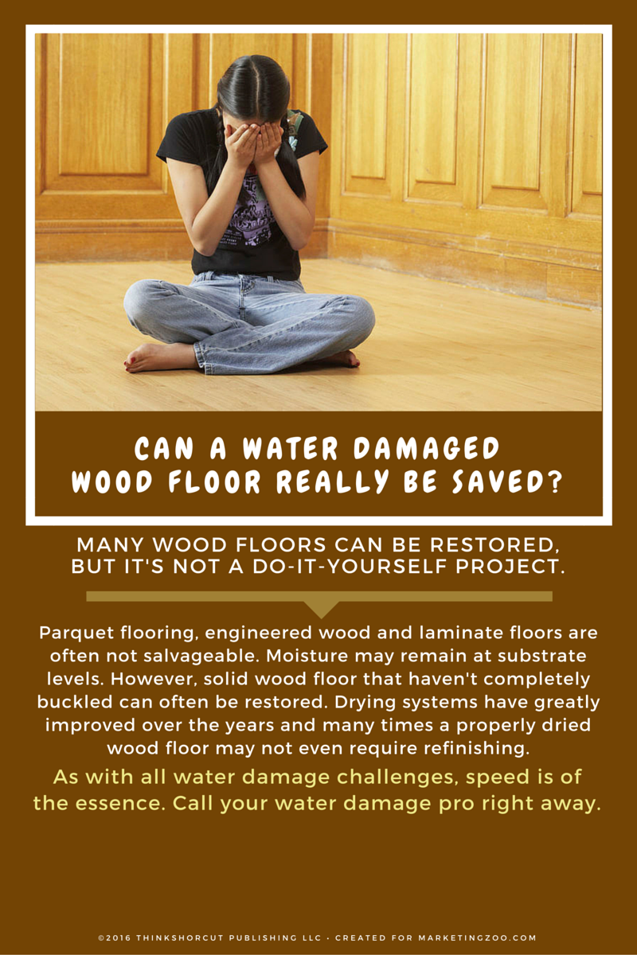
Mysterious Mustiness
What do you do when you notice a mysterious “musty” odor in your home? Nothing is broken. There was no big storm. The sump pump is chugging away like normal.
Mysterious musty odors can be caused by a variety of situations. Figuring out where they are coming from and remediating them is the challenge. What are some common causes?
Ice dams are the bane of winter. They develop when snow accumulates on a roof with a slope, the snow starts to melt and the water slowly moves down the slope to the eaves or gutters. The water can’t drain because of the amount of debris in the gutters, such as from leaves. It then refreezes, creating an ice dam, which means during the next thaw water can’t drain through the obstruction. This then causes leaks through the roofing material, and into your home. If the water intrusion is minimal, you might not even know it is happening, until your nose knows… detecting that mysterious musty odor.
Leaky drains are another cause of musty odors. If the leak is very slow, water can drip, drip, drip… and over time cause damage under sinks. You don’t notice it because it’s hidden, and the amount of water is contained in a small area. But you start to notice the smell, that mysterious mustiness that you are determined to eradicate.
Severe condensation on windows is easy to see but often homeowners don’t appreciate the damage potential. This odor-causing issue is caused by excessive moisture in the home, especially in winter when windows draw moisture onto cold surfaces. The moisture itself isn’t the problem. The problem is when the moisture moves down into the window sills and any natural woodwork or even wall interiors get wet and create that mysterious musty odor.
What can you do? Inspect all areas in your home that water can intrude or accumulate. Your restoration pros have the equipment to do it right, with moisture meters and special cameras that detect moisture. Be smart. Give them a call.
Short & Simple • © 2016 Thinkshortcut Publishing, LLC • Created by MarketingZoo.com

Slide 2
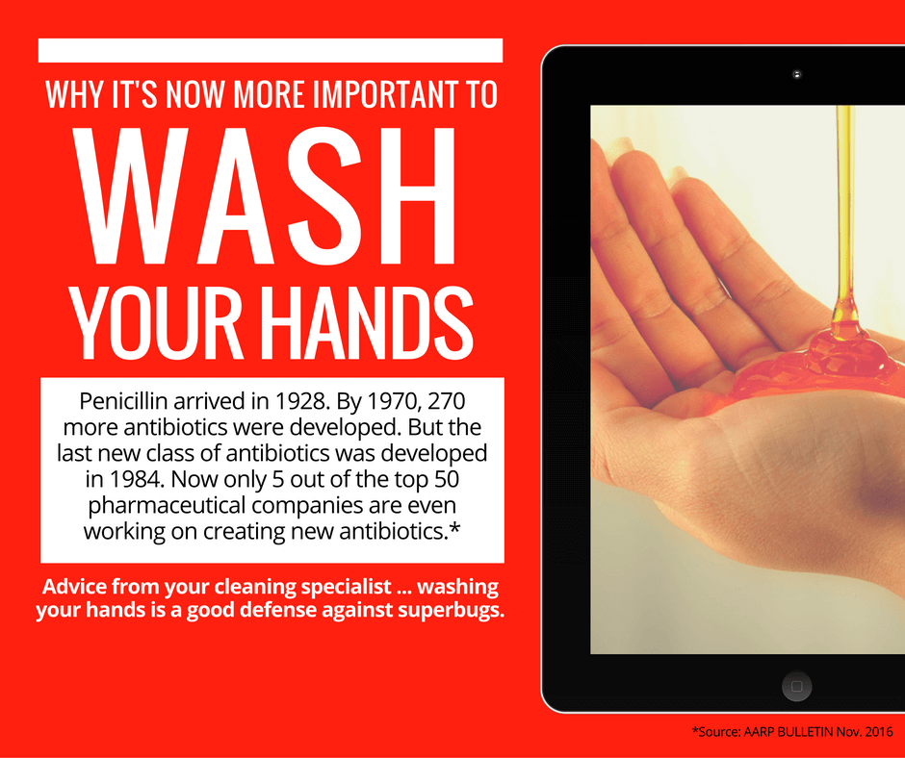
Kitchen Health Hazards
The surfaces in a kitchen that are considered health hazards are probably not at the top of your list of household concerns, but statistics show that a closer look at countertops, cutting boards and other food preparation areas where you slice and dice your way to your favorite meal is warranted.
As stated by Dr. Charles Gerba, a noted microbiologist and professor: “In most cases, it’s safer to make a salad on a toilet seat than it is to make one on a cutting board.” Ick.
Let’s look at three common surfaces where there is food contact and what can be done to protect the health of yourself and your family.
Countertops
We take them for granted as the most common food preparation surface, and yet we often don’t pay enough attention to how clean they are. Especially close to the sink, where most food prep usually takes place. Make it a daily habit, and especially after preparing tasty meals that include meat such as chicken and pork, to use a disinfectant kitchen cleaner and paper towels. But don’t just spray and wipe. Spray the disinfectant cleaner all over the countertop and give it a few minutes to work, and then wipe it off.
Cutting boards
As previously mentioned, cutting boards have been known to be so contaminated that toilet seats are considered to have less contamination.
Most people, after preparing food, quickly rinse and wipe off their cutting boards, leaving a teaming army of bacteria behind. Just like with countertops, a disinfectant cleaner is important. Even better? Have several cutting boards in your kitchen and after using one, put it in the dishwasher. Done. Clean. Healthy.
Sinks
Many bacteria tests of kitchen sinks reveal a collection of E. coli. Why? Unless you are on vacation, your kitchen sink is always wet, which is what bacteria thrives on. Add food particles to the mix and the bacteria has a huge buffet to feast upon. Frequently spray the kitchen sink with disinfectant cleaner, give it time to work, and then rinse with hot water. Do this daily. Doesn’t take much time at all.
Of course, when you want peace of mind and a healthy home, especially when you are too busy to do it yourself, call a pro. Your professional cleaning service knows how to clean it all.
Short & Simple • © 2016 Thinkshortcut Publishing, LLC • Created by MarketingZoo.com

