Slide 1
Evidence of Water Damage
When something fails, such as a high-pressure fresh water source to your toilet… or perhaps a leaky drain pipe underneath the kitchen sink… no matter what it may be, you usually know what to do.
You know the drill… clean it up, get it dry, and call a professional water damage restoration company to ensure all is good and there is no possible way mold can grow. You want peace of mind, and this is the way to get it.
However, sometimes you just don’t know when things happen, when things leak or when water intrusion occurs — because it can be slowly invasive and build up over time.
There are several steps to determining if you have an actual water damage situation and when you must call a pro — and when you can do it yourself. Remember, you can’t be too cautious with the well-being of your loved ones.
The nose knows. Damp and wet areas affected by water intrusion demonstrate themselves after a day or two with a very easy to detect odor. It will just smell wet, musty, and unhealthy. If you detect anything like that, it’s time to do some serious investigating. You may not actually see the water intrusion, but no doubt it is probably there.
Surface damage. You can often see swelling materials, such as the particle board under a sink, providing evidence of water intrusion.
When things buckle, even if you notice it after the surface has dried, there is potential of subsequent water damage, because if it leaked once… it will again!
Stains. You can usually see this in the ceilings and areas around water sources. Sometimes it is around windows. If you detect water marks (think of a carpet under a water fountain in a building) then you need to put your investigative hat on and figure out if it is a big deal or not — and most likely, it will be a big deal.
The evidence of water damage can be easy to see, and sometimes it hides and continues to affect surfaces and your health until it becomes a serious issue. If you have any water damage issues or questions, do the right thing. Call your favorite water damage professional company today. After all, it pays to call a pro!
Short & Simple • © 2018 Thinkshortcut Publishing, LLC • Created by MarketingZoo.com

Slide 2
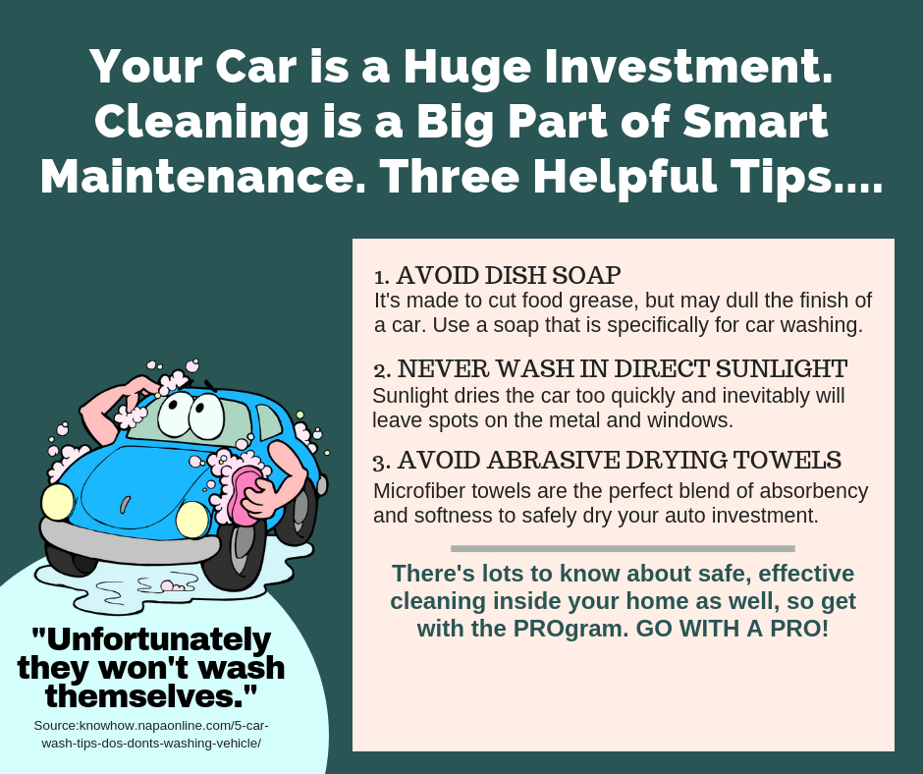
The Nooks and Crannies
Your home has plenty of areas for dirt and grime to hide. Locating them may seem easy. Cleaning them effectively is something else.
Most homeowners spend plenty of time sweeping, vacuuming, scrubbing, and cleaning areas that are obviously soiled and become soiled daily. There are areas that can really get gross in a short amount of time.
Your bathroom “work stations” — also known as vanity cabinets — are prime locations for soil buildup. Let’s spend some time on how to tackle the chore of cleaning the bathroom vanity. One area of the home easy to ignore. After all, who looks in there besides the person searching out some face cream or hand lotion, among other items?
The buildup of residues can wreak havoc over time. Think of hairspray that you use daily and that ends up on the top of the cabinet. It may be easy to clean when fresh but give it 10 or more applications and you have a “goo” that’s not giving up its tenacious hold on the counter. This isn’t to even mention toothpaste and other necessary items that get smeared on the same surface.
Take some time each day — perhaps just a minute or so — to quickly wipe up any residues that land on the surface.
Then, take some time each week — perhaps just five minutes or so — to open up any cabinet
doors or mirrors that house storage behind them, remove all objects, and use a household cleaning solution to wipe down all surfaces. After a week, you will still be amazed at how much residue has built up in there. Imagine what could happen after a few months!
And once a month, give your entire bathroom a close scrutiny and look for all those nooks and crannies that can be the host of soil. This could be behind the toilet, in the corners of shower stalls, where the soap resides on the bathtub edge. All these areas could use a good scrubbing each month, if not more frequently.
And all this is besides the typical routine cleaning you no doubt give all your bathrooms.
But when you need some real help, from your favorite cleaning service, do the right thing. Give them a call today. After all, it pays to call a pro!
Short & Simple • © 2018 Thinkshortcut Publishing, LLC • Created by MarketingZoo.com

