Slide 1
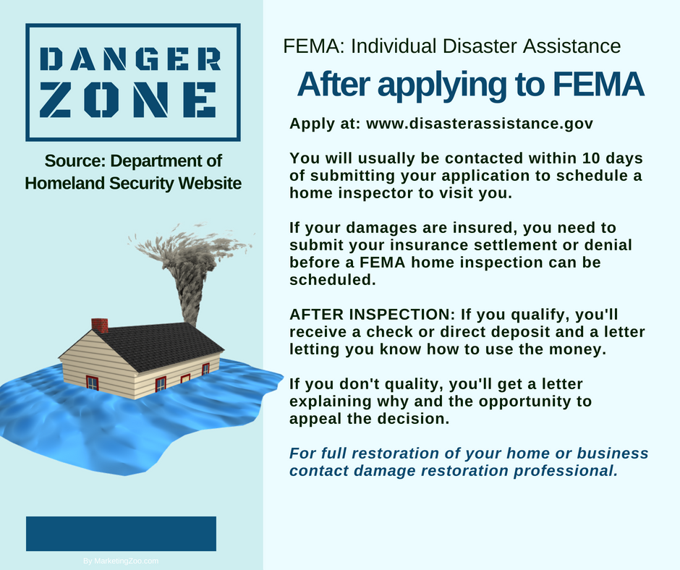
How to Avoid a Moldy Basement
What can you do to avoid a moldy basement problem? There are several simple steps and procedures…
Know your numbers
It’s important to understand humidity and monitor those moisture levels in your home. A simple hygrometer you can buy online or in a retail store gives you this information, as easy as a thermometer tells you the temperature.
Use a dehumidifier
Basements are known to be humid and damp, even with no evident moisture intrusion issues. A dehumidifier can remove many pints of water from the air each day. You can choose one that you have to dump the water from on a schedule, or have it drain automatically into a floor drain or sump pump. You will be amazed how much water you can remove and keep mold at bay with a dehumidifier.
Use exhaust fans
Simple fans can be installed that move moisture-laden air from the inside to the outside, like you would do with a bathroom exhaust fan. This might be a chore for the pros, so have them take
a look at your home and see what options they might offer.
Inspect outside drainage
One issue that is common is moisture building up on the outside of block walls, and this moisture can seep into the interior walls of those blocks, adding too much humidity in the basement. Ensure all ground water flows away from your home and doesn’t puddle up against the walls.
This advice is for common issues. But if the worst happens, such as a broken pipe or water flooding into your home, now you are into a serious issue. Do the right thing and call your water damage restoration company today. After all, it pays to call a pro!
Short & Simple • © 2018 Thinkshortcut Publishing, LLC • Created by MarketingZoo.com

Slide 2
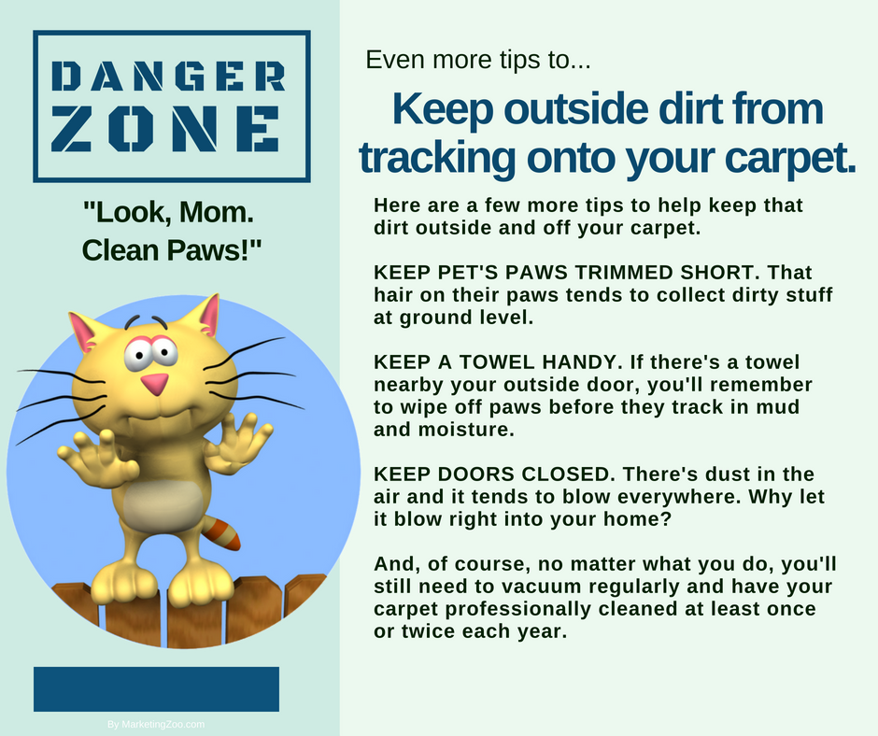
Cleaning Up ‘Accidents’
With owning a pet comes responsibilities. Some obligatory, such as taking them to the vet for annual checkups. Others more of a necessity, such as cleaning up after they make a mess, from turning over the food dish to the previously mentioned hacking or barfing — or other issues that create a smelly, visible mess that must be dealt with.
Pet accidents. They happen to every pet owner. And are they really “accidents” — as if the pet didn’t really mean to do it? That’s another story entirely. Here are a few basic steps to consider when cleaning up “accidents”.
Scrape or wipe it up — all of it
No matter the mess, whether tossed up tidbits from the food bowl to a hacked-up hairball to urine or feces in the carpet, the first order of business is to clean up excess residue. There’s no point to applying cleaning product or deodorizer to substance that you can remove with a few paper towels.
Blot and blot… and blot some more
Now is the time to get as much moisture (gross!) out of the carpet or off the flooring material, or even off furniture. Using white, absorbent paper or cloth towels, push down on the affected area. Do not scrub. Absorb as much contamination as you can.
Apply product — and clean!
The final step is to clean up all remaining residues from the surface. Always pretest colors and fabrics before adding cleaning products, although most surfaces are fairly durable and can handle mild cleaning agents. Get some ideas for the best products from your local carpet cleaning company. Control the amount applied with a flip-top bottle or adding the product to a white, absorbent paper or cloth towel. Work into the area and clean away the contamination. If you remove it when fresh, there should be no residual issues.
Sounds easy, right? It’s not always this easy. When you have difficult cleaning challenges, do the right thing. Call your professional cleaning company. After all, it pays to call a pro!
Short & Simple • © 2018 Thinkshortcut Publishing, LLC • Created by MarketingZoo.com

