Slide 1
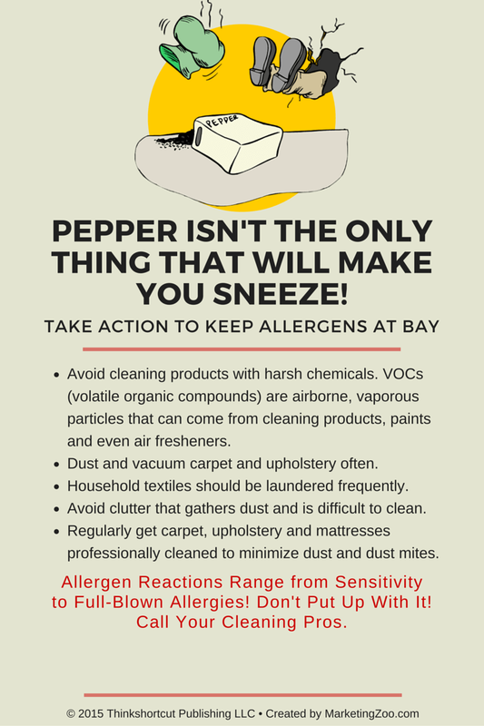
Prepping the House – Part 1
When the weather turns bad, it’s time to turn against the weather.
Prepping your home for storms that are either predicted or that can occur at any time is the best defense against wind, water and related storm damages.
Without proper winter preparation of your home, you may end up inviting wind, rain and snow inside and then calling a restoration pro to clean it all up.
Tip #1: Inspect the windows
No, not in the glass itself (you can see that easily and would have already replaced broken windows.) Check the weather stripping, the caulking and edges of the glass. Ensure no air is getting in or out. This is easier to check on a windy day. Hold a tissue paper up to the areas you are inspecting to see if there is any movement. If so, repair that area. Replace the caulking or weather stripping if necessary.
Tip #2: Get climbing…
… up on the roof, that is. But keep it safe! Hire someone if you aren’t able to physically do this yourself or if there is any danger of falling. You (or someone) needs to inspect your roofing materials, areas around chimneys and vents… anywhere that water can intrude and cause problems. Be sure to repair any damage before the weather turns bad.
Tip #3: Clean the gutters
Dirty, cluttered gutters don’t do their job very well. Rain can easily turn into snow and ice, and debris in the gutters means they clog up and can cause all kinds of problems for your home. When the leaves stop falling, get out the ladder or hire a pro to ensure your gutters are ready for winter.
“No matter what you do, occasionally water, wind and ice can damage your home. Do the right thing: Call your disaster restoration and/or cleaning pro when professional services are needed.”
Short & Simple • © 2015 Thinkshortcut Publishing, LLC • Created by MarketingZoo.com

