Slide 1
How to Take Care of Your Outdoor Grill
Keeping that gas grill in good shape is, therefore, paramount to happy outdoor barbecues and family gatherings. And here’s something we all know: Outdoor gas grills don’t clean or take care of themselves. It takes determination on your part to keep them working for you, meal after meal after meal.
Here are a few easy steps to keeping your gas grill in good shape.
Step 1: After cooking your favorite treat on the grill (after removing all the food to a platter, of course) keep the grill on. In fact, turn it up a bit, and let all the bits of meat and drippings burn to a crisp so after everything cools you can scrape them off the grill grate. If you don’t do this, the next time you fire up the grill means you will be dealing with the remnants of the previous meal. That’s not tasty.
Step 2: Look underneath… no matter the quality of your grill, if you have a storage area for pans, spatulas and the propane tank, food drippings and debris can quickly create a problem. Clean out that storage area on a regular basis, keeping everything neat and ready for the next meal.
Step 3: Don’t ignore the exterior of the grill. Washing the outside of the grill with warm, soapy water keeps grime from building up.
Step 4: When not in use, keep everything covered up. Some feel that with warmer weather, they can leave the grill exposed to the elements. Hey, it’s meant to be outside, right? Yet keeping the grill under a quality grill cover can add years of life to your trusty outdoor cooking partner.
Of course, with outdoor grilling comes greasy spills that can spot and stain your carpet.
Nearly everyone has dropped a burger or a hot dog on
the floor when bringing the food inside. Even worse is
when your tasty treat is covered with mustard or ketchup. Do your carpet a favor and call your professional carpet cleaning company when that happens.
Short & Simple • © 2016 Thinkshortcut Publishing, LLC • Created by MarketingZoo.com

Slide 2
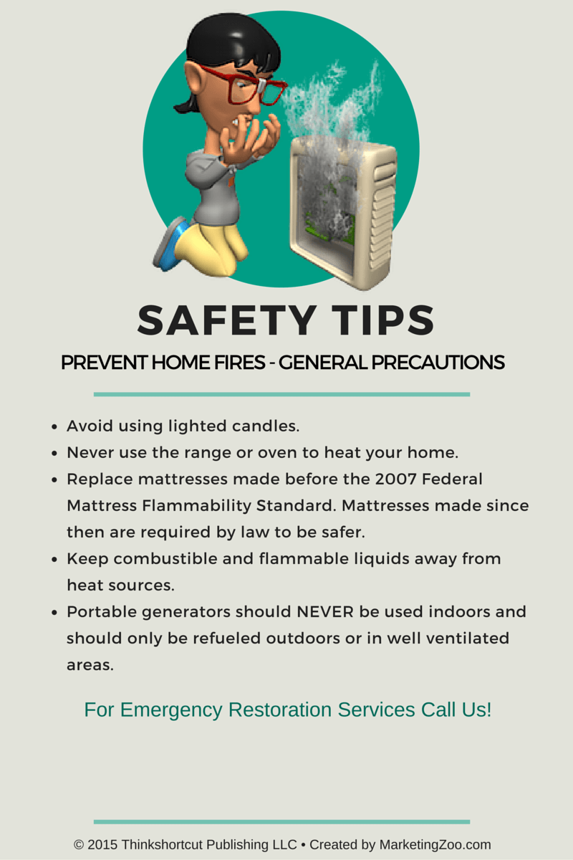
How Dangerous is Mold in Your Home?
Everyone wants the safest, healthiest home environment for their families. You would do anything to protect your loved ones from exposure to any substance that could cause them harm.
One of those feared substances is “mold” and with what you have seen in the news in recent years, exposure to harmful or “toxic” mold has affected the health of countless people — folks just like you.
This brings up the all-important question: Just exactly how dangerous is mold in homes?
That’s a tricky question, because there are many types of mold and mold is virtually everywhere. There is probably a little bit in your basement right now. Your shoes when you came home yesterday no doubt brought in a few mold spores. Mold spores can be in breathable space and travel in the air.
When you step outside, you are surrounded by mold. There’s nothing you can do about that. The main concern is usually what’s in the home, not outside, although if you are sensitive to mold you should avoid all damp areas that could promote mold growth, inside and out.
Some people are affected by even the smallest amounts of mold. They may have nasal issues, watery eyes, coughing and other physical reactions. A smaller segment of the population are very sensitive to exposure to mold, having severe reactions that can be life threatening. Others aren’t affected at all, and can be around and/or exposure to all types of molds with no apparent sensitivities. The issue is twofold if mold is growing in your home. You must clean it up or have it cleaned up, and fix the moisture problem.
“You can do your research on how to fix the problem, but the best solution is, no doubt, getting expert advice from your professional water damage restoration contractor or mold removal or remediation company. Keep your family safe. Call the experts.”
Short & Simple • © 2016 Thinkshortcut Publishing, LLC • Created by MarketingZoo.com

