Slide 1
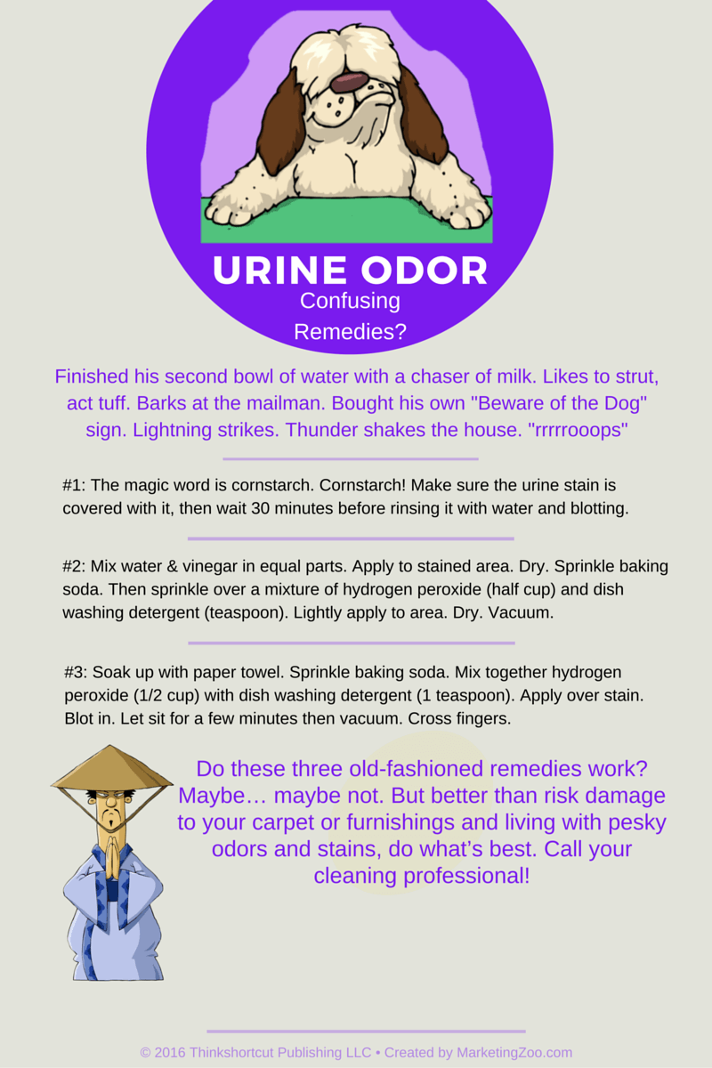
Keep Mold at Bay: Take Away its Food
The Centers for Disease Control and Prevention recognizes how water damage situations (such as from a flood, leaky or broken pipe, sewage backup, etc) can be potentially hazardous… not just initially, but over time as well.
Why? Because of the potential of mold and how it affects human health. Exposure to damp and moldy environments and materials can be especially harmful to those sensitive to irritants common to mold contamination. Some find that even being outside near plant life in the process of decomposition is a problem. Mold and mildew can run rampant under certain conditions, causing allergic reactions.
So when a water damage does happen in your home, don’t take chances. Mold needs moisture. It needs to be fed. It will grow on organic materials that are wet. If you take away its “food” you inhibit the ability of mold to grow.
Important reminders: Remember that mold will grow in places with a lot of moisture, anywhere there is a leak. This can be around windows, behind walls where water has intruded, from leaky roofs, and especially from leaky pipes – especially those that are leaking and you didn’t know about it!
Many homeowners are tempted to clean up water that comes into their home, such as when a sump pump might fail or when a toilet might overflow. Good intentions for sure. But if you don’t get it really dry, really fast, there can be problems.
Here’s a scary thought: Some professional water damage experts won’t even do a water removal job if they can’t get to it within 24 hours. They know mold could have started to grow and that means more work than simply extracting water and drying the home could be required.
You don’t want all that headache. When any water intrudes into your home, remember it’s more than water. It’s breeding ground for mold. Do what’s best. Call your water damage pro!
Short & Simple • © 2016 Thinkshortcut Publishing, LLC • Created by MarketingZoo.com

Slide 2
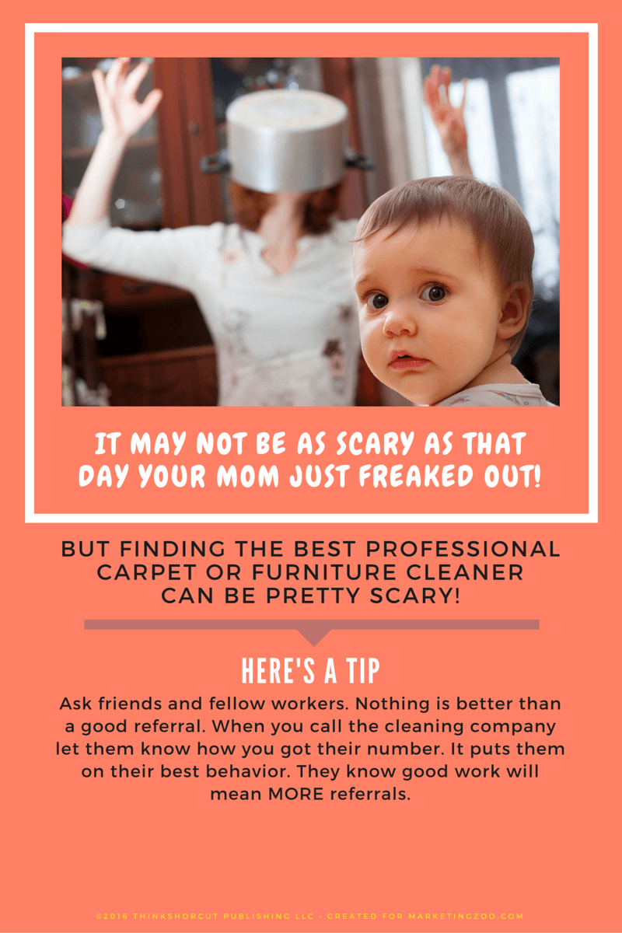
Removing Blood Spots from Carpet and Furniture
Blood spots on your carpet or on your furniture… what a terrible thing. But blood spots can be removed fairly easily if you get to it quick enough. Of course, if there is a fair amount of blood, more than just a few spots, it’s best not to do anything except call a pro.
For a small amount of blood, follow some simple, safe procedures.
Blot. When you have a fresh blood spot, get a white absorbent and disposable towel (like a paper towel without print on it) and blot up as much as you can. Never rub or scrub. That can damage the color and/or texture of the fabric, especially furniture fabric.
There is probably still a spot remaining, even with a lot of blotting. So take about a quart of luke-warm water in a bowl, and add a drop of dish soap to it. Just a drop, you don’t want to leave any sticky residue behind. Dip a fresh, white absorbent and disposable towel into the solution and carefully blot the blood again. What you are trying to do is use the detergent solution to release the blood from the fibers into the towel.
After that, if there is still some light blood staining remaining, use a fresh, white, absorbent and disposable towel to apply a 3% solution of hydrogen peroxide, the same strength you purchase at a drug store. But remember, hydrogen peroxide is a “bleach” and you must be careful with colors, especially on furniture fabrics. It’s best to test an area like on the back, bottom skirting to make sure the colors aren’t affected.
Phew! That’s a lot of work. And it might do the trick, but it might not. You could set the blood and it could become a difficult stain if you aren’t careful.
“So if you don’t like to live dangerously and would rather play it safe… call your favorite carpet and furniture cleaning company. They know exactly what to do and they have the tools and cleaning solutions to do it right!”
Short & Simple • © 2016 Thinkshortcut Publishing, LLC • Created by MarketingZoo.com

