Slide 1
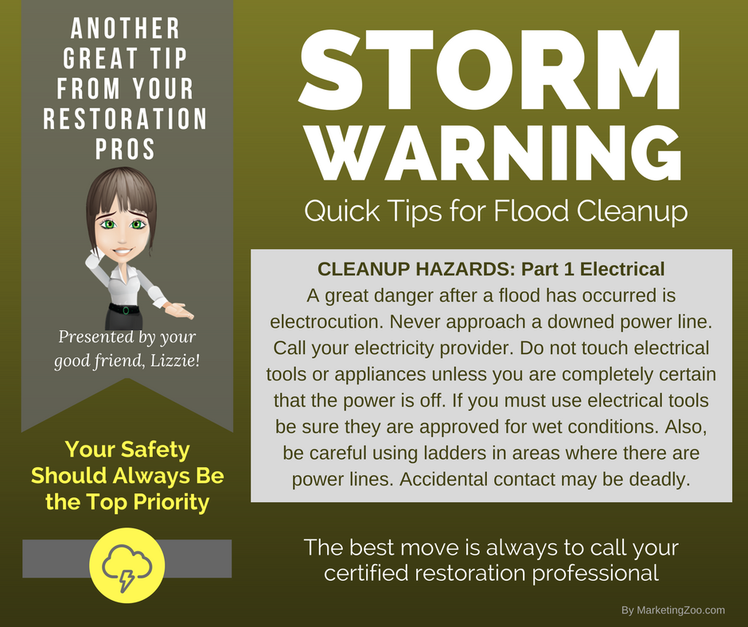
It’s Bib Time!
Each year, just about November, homeowners living in colder climates must think about a simple winterizing job.
And if you don’t live in colder climates, read on… because this will help you feel better about where you choose to hang your hat!
When winter comes along, most think about what they can do to keep their house warm and draft-free. They make sure any weather stripping is in good shape; they have the furnace and/or fireplace inspected; and perhaps have the ductwork cleaned.
What many don’t consider is what’s outside, such as the hose attached to the hose bib on the side of the home. You know, what you used nearly every day to water the lawn, garden, and flowers.
Remember, water freezes at 32 degrees Fahrenheit, and while that may not feel so cold to you as you wear a light sweater or jacket, it’s enough for ice to form and pressure to build up in the hose bib.
When that happens, the pressure that builds up can damage the hose bib and break it.
You might be saying, “I have a frost-free hose bib” — and while that is good and even better than a traditional hose bib, don’t trust it too much. They have been known to fail and cause flooding in homes.
Now, you might be wondering why all the fuss. The hose bib might freeze and break and… it might not. If it does break, nothing really happens all winter and you just might think all is well. The problem is in the spring. When that hose bib is turned on, the break from the frozen water is back in the wall, not outside the wall where you hook up the hose. So as you are merrily watering away during a nice, spring day, you are also watering the inside of your home, perhaps flooding your basement with water.
You can test your hose bib easily in the spring. Hook up your hose, crimp it, and turn on your hose bib. Listen carefully. If you hear water running in the wall, quickly turn it off. You have a break and probably need the services of a plumber. But if the worst happens, and you do have any type of flooding in your home — no matter the source — do the smart thing. Call your water damage company.
Short & Simple • © 2017 Thinkshortcut Publishing, LLC • Created by MarketingZoo.com

Slide 2
Brighten Up Those Lights!
While most people concentrate on cleaning floors, counter and table tops, bathroom fixtures and often-used areas of the home, one surface can often be ignored.
And it’s the brightest surface in the home!
That’s right. Light fixtures. Many homeowners spend lots of time (and money) choosing the best fixture for each particular room. Some of them are subdued; others are extravagant. No matter which type you have, when a light shines on or shines through a surface, the dirt shows up and is often magnified. It can look worse than it really is.
So take a minute… look up, and inspect your light fixtures. Do they need some attention?
If so, here are some quick tips to handle those shiny surfaces. Of course, be sure to turn off the lights so the bulbs can cool, and it wouldn’t hurt to disconnect the power for some light fixtures.
Dusting: A simple dusting and dry wiping of glass surfaces can do wonders. Using a duster or cloth treated with a product designed to attract dust helps transfer dust to the cloth.
Washing: If the glass fixtures can be complete removed and separated from the electronic components of the light, you can wash them in a sink of hot, soapy water like any other glass object. Be sure when you do this that you carefully rinse the fixtures and dry them completely, holding them up to light to make sure you remove any streaking.
Reinstalling: This is the opportunity to look for more dust and debris. Look for cobwebs, bugs, and other debris that might be on fixture surfaces separate from the glass. Again, be safe! Make sure the power is off to any fixture you work on. When everything is clean, neat, and tidy, turn on your lights. You will be amazed how great everything looks.
Short & Simple • © 2017 Thinkshortcut Publishing, LLC • Created by MarketingZoo.com

