Slide 1
Power Cord Safety
One aspect of power and electricity that is often ignored or forgotten is what carries it to various devices in your home. That’s right… the power cord plays an integral part of using electricity and should also be a concern when it comes to safety issues.
In addition to the installed power cord, extension cords are frequently used to increase the range or reach of electrical outlets. No matter which type of cord you are using and the length, consider these safety tips to protect your home and family.
Check for damage
Make sure your power cords don’t have any cracks or breaks and aren’t frayed in any way. Replace rather than repair.
A good fit
When you plug a cord into a wall outlet, it should be snug, not loose and falling out of the socket.
The third prong
It may be tempting, but some outlets, such as in older homes, may not have the third hole. It’s an important safety
component of modern outlets, as it grounds the electrical current.
Never remove the third prong from cords.
Match cords to usage
Choose cords that are of proper weight and length and can carry the electrical load appropriate for the device being powered. Ask your electrician for details, if needed.
Place them carefully
Make sure cords are placed where they won’t be a tripping hazard, and never put them under rugs or other furniture, especially heavy items, which can crimp and break the cords.
If the unthinkable occurs and you do experience a fire of any kind, and related smoke damage, do the right thing. Call your favorite disaster restoration company. It pays to call a pro!
Short & Simple • © 2018 Thinkshortcut Publishing, LLC • Created by MarketingZoo.com

Slide 2
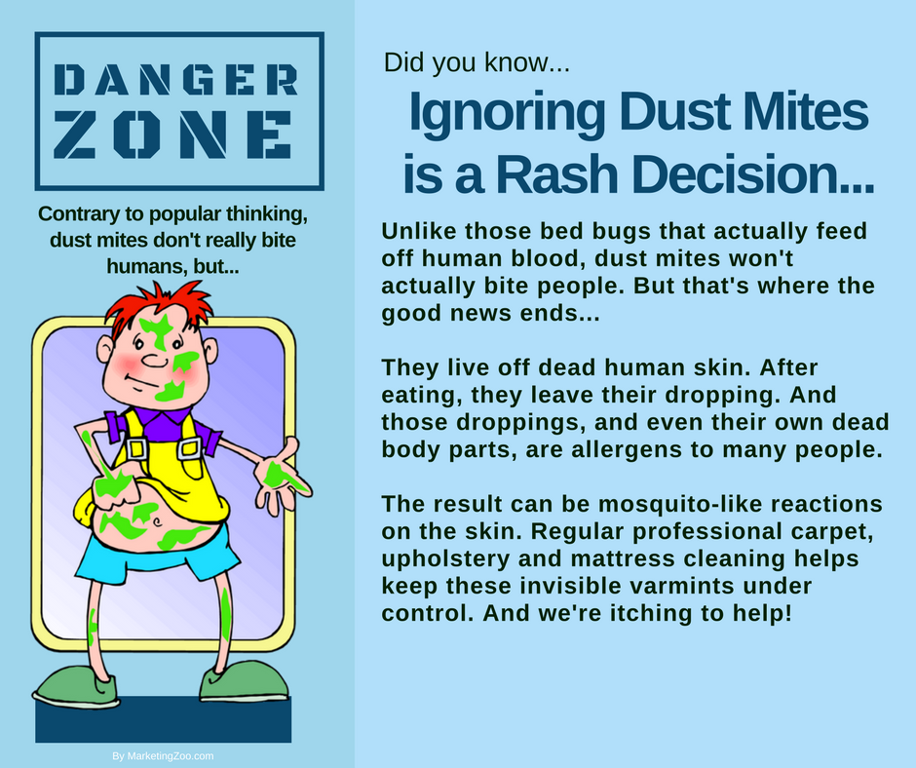
Is Your Microwave… a Crud Collector?
The microwave oven is a modern invention. The first microwaves were around in the mid 1940s. They were massive devices that had to be cooled continuously by water flow. The popularity along with more affordability began in the 1980s and microwaves as a common fixture in the kitchen is now here.
Virtually everyone has one. If you don’t, you are in the minority. What all microwave users have in common is cleaning up the mess that inherently comes with using these handy ovens that can cook snacks or complete meals in seconds or minutes instead of hours.
To ensure your microwave oven not only looks good but also operates efficiently, you must keep it clean. Here’s how.
Scrape it. As with any cleaning task, scraping up as much as you can before applying cleaning agents is smart. Food particles and residue that resulted from an “explosion” of food can easily be scraped away from the walls and ceiling of the inside of the oven.
Spray it. When you have scraped up as much as possible, use an appropriate cleaning solution and liberally spray the interior of the microwave. Give it some time for the solution to work, perhaps five minutes, and then wipe away the grime. But if there is a lot of grime, continue reading and do this…
Steam it. Fill a microwave-safe bowl about two-thirds full of water. Put it inside the microwave and heat it up on high for about three to five minutes, or until it is boiling. Don’t open the door! Let the bowl sit in there for approximately 10 minutes, allowing the steam to loosen up the grime. Then…
Wipe it. Spray the moist interior of the oven with more cleaning solution, and use paper towels to wipe all interior surfaces. Even the toughest grime should come off after all your prep work.
Other dirty surfaces. Microwave ovens aren’t the only grimy things that can be part of the modern household. When you need any of your surfaces cleaned, such as carpet, furniture, hard floors and more, call your favorite cleaning company. It pays to call a pro!
Short & Simple • © 2018 Thinkshortcut Publishing, LLC • Created by MarketingZoo.com

