Slide 1
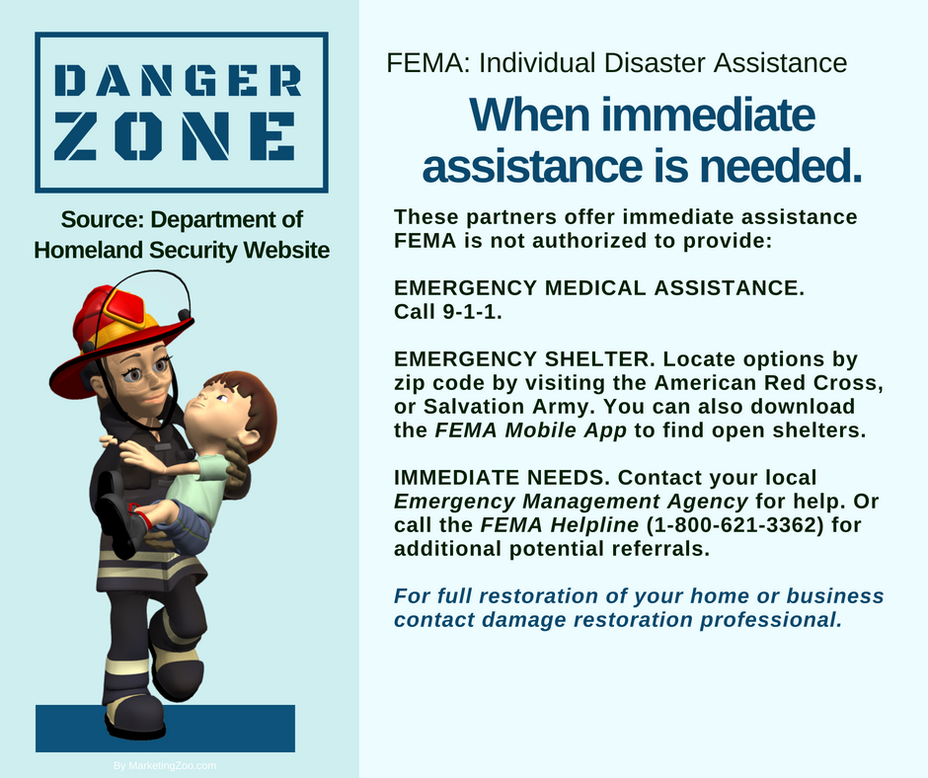
Categories of Water Damage
Did you know that water losses are given classifications? One water loss isn’t always like the next. There are differences.
Many water damage situations involve a basement, and often a sump pump failure. Others are from leaky pipes or even broken pipes. When this occurs, along with other types of water loss situations, did you know the water type is classified by professional water damage restoration experts as “clean?” That’s right. Even if it looks dirty, because of a lower amount of potentially hazardous contaminants in the water, it is given a “Category 1” classification. However, this type of water loss can quickly escalate into a more dangerous situation, if not removed and affected materials dried out quickly.
Then we have water damage situations that may contain potentially hazardous contaminants and bacteria that could be harmful to your health. An example would be a toilet that overflows, that doesn’t involve raw sewage. This would be a “Category 2” classification. A Category 1 can become a Category 2 if left unattended, because of bacteria and microbial growth occurring over time.
And it gets worse from here. A “Category 3” water damage situation is “black” water and is always considered dangerous to the health of occupants in a home or building. An example would be a raw sewage backup and contamination. Another would be flood waters, since you aren’t sure of the source of the water or where it has been. The contamination involved would dictate wearing personal protective equipment and even respirators. Never risk your health.
For Category 1 and Category 2, there is a chance you could extract and dry the area yourself. Often, it ends up in frustration and even mold growth. But for Category 3, never attempt this on your own. In fact, play it safe. Always call a professional water damage company when you have any type of flooding situation in your home. After all, it pays to call a pro!
Short & Simple • © 2018 Thinkshortcut Publishing, LLC • Created by MarketingZoo.com

Slide 2
Caring for the Commode
Cleaning the commode — aka “the toilet” — is a task that must be done on a regular basis, because if you don’t do it… well, you know. Put it on your calendar to-do list.
The first item you need is a good quality toilet cleaning brush. If your water quality is considered “hard”, purchase one that can provide some mild abrasion, such as a wire brush. This will help with the difficult task of removing mineral deposits. But don’t overdo it; you can scratch the surface of the commode, inside the bowl. Now you need a quality cleaning product. This is where you really need to consider your best options.
A commercial-grade cleaning product is obviously the best choice, as it will handle most residential cleaning challenges with ease. There are no doubt some supply houses in your area that have these types of products, and most big-box stores also carry similar brands. If you neglect cleaning for a period of time, you will need one of these stronger products, usually a potent acid-based cleaner. If you keep your commode clean on a schedule, a milder household product should suffice.
Choose a cleaning product that has a spout you can use inside the bowl, applying the product up high under the rim of the bowl.
Grime and mineral deposits like to hide there. Apply your cleaning solution thoroughly, using your brush to agitate the surface inside the toilet, and allow a few minutes of contact time for the product to work. Then agitate again and flush. Inspect, re-clean if needed… and you should be happy with the results.
As always, using cleaning products is partnered automatically with a few warnings. Don’t allow it to contact your skin, so use gloves. And don’t forget the eye protection glasses or goggles. Safety first!
Never forget, however, that the absolute best cleaning of your home, whether in the bathroom or the living room, from hard floors to carpet, and more, let your favorite cleaning company do the work. After all, it pays to call a pro!
Short & Simple • © 2018 Thinkshortcut Publishing, LLC • Created by MarketingZoo.com

