Slide 1
How (and Where) Is Your Fire Extinguisher?
A house fire is an unthinkable event, yet one that occurs more often than you might think.
Some of the more common house fires start in the kitchen, often from cooking. A small grease fire can quickly grow and become devastating. Others can ignite from faulty wiring or over-loaded or overworked appliances. Still others are accidents, such as from turning over a kerosene-fired heater or a burning candle.
When any of those events occur, being ready for action is vital. Calling the fire department is at the top of the list. Battling even the smallest of fires without help on the way can be deadly.
When a fire does occur, it’s natural to grab the fire extinguisher. But… where is it? Why not do a simple test. As you read this, ask those in the home right now if they know where the fire extinguisher is located. You might be surprised by the responses. But don’t get mad at anyone. Being unfamiliar with the location of the fire extinguisher is common.
Then there are various types of fire extinguishers. Which one should you have? That’s a question you should ask of your fire-fighting professionals. Not having the proper extinguisher can be as deadly as not having one at all.
So far, this discussion has been about one fire extinguisher. Yet you should have them placed strategically throughout the home, especially areas prone to fire. This could be several extinguishers of various types for a single dwelling.
Finally, everyone in the household needs to know how to operate the extinguisher. According to FEMA, there are four basic steps, that could be remembered with the acronym PASS:
Pull the pin and hold the extinguisher away from you and release the locking mechanism.
Aim low and point the extinguisher at the base of the fire.
Squeeze the lever slowly and evenly.
Sweep the nozzle from side-to-side.
Of upmost importance is listening to the experts. Contact your local authorities for the absolute best fire prevention advice.
And if the unthinkable happens, and a fire does occur in your home, don’t forget your disaster restoration professionals are ready for action. They can restore your home and belongings. After all, it pays to call a pro!
Short & Simple • © 2017 Thinkshortcut Publishing, LLC • Created by MarketingZoo.com

Slide 2
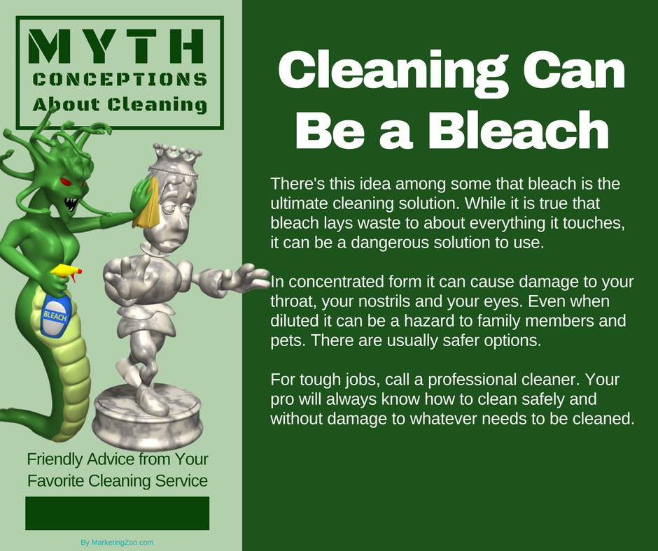
The Chewing Gum Dilemma
Walking along and enjoying the day and we notice a bit of stickiness underfoot. We stop, awkwardly lift the affected foot and inspect the bottom of our shoe. Yep, there it is. A glob of chewing gum. It has attached itself and has seemed to have taken up permanent residence underfoot.
Getting a bit of gum on the bottom of our shoe may be a common occurrence and yes, it is a little gross as well, considering it spent many minutes in someone’s bacteria-ridden mouth. Hey, we all have bacteria!
But the procedure for removal is easy, as you grab something to scrape it off and no doubt just go about your business, with the friction of the show hitting the ground eventually removing the residue.
However, when gum gets into clothing or other fabric, that’s a different challenge.
Removing gum when it is warm or room temperature is very challenging. Without special solvents that the professionals use, you might just make a mess of the chore. So you make the best of what you have. And that’s something cold.
With gum in carpet or an area rug, use an ice cube in a small, zip-lock bag. Rub the ice cube on the gum until it starts to harden and when it seems hard enough, break the gum off the fibers. Just don’t force the issue as you could physically damage the fibers.
You now need to deal with the residue. A very small amount of dry solvent, such as rubbing alcohol, on a white cloth can help remove the residues. Contact your favorite carpet cleaner for complete advice and to avoid damage.
For clothing or garments, you can be a little more aggressive. Put the affected item in a bag and stick it in the freezer for several hours until completely frozen. Immediately after removing the item from the freezer, break off the gum. Any remaining residue can be removed with typical laundry pre-treatment products and then, of course, put the item in the washing machine. Upon removal, before drying, make sure there is no remaining sticky residue. If there is, use a dry solvent on the spot and wash again.
Sounds like a lot of work? It is. That’s why when you need anything cleaned, it pays to call a pro!
Short & Simple • © 2017 Thinkshortcut Publishing, LLC • Created by MarketingZoo.com

