Slide 1
What Can FEMA Do for You?
The Federal Emergency Management Agency (FEMA) provides help to many of those in need; homeowners and others that need special aid when a disaster strikes.
Although the government and its workers are not always quick to respond, you can get the process started by visiting this link. You can also call the FEMA helpline at (800)621-3362.
After you apply for disaster assistance, FEMA will mail you a copy of your application and a copy of a document entitled “Help After a Disaster.” This is especially helpful if you don’t have insurance coverage for the disaster event your family is facing. This happens more than you think.
Here is what FEMA says they will do for you, in part, according to the government website:
If you do not have insurance: An inspector will contact you after you apply to schedule a time to meet you at your damaged home.
If you have insurance, you need to file your insurance claim and provide FEMA with a decision letter (settlement or denial) from your insurance company before FEMA issues an inspection.
There is an exception for damages caused by flooding; if you have flood insurance, FEMA will issue an inspection before receiving a copy of your flood insurance decision letter to evaluate your eligibility for temporary living expenses since these are not covered by flood insurance.
About 10 days after the inspection FEMA will decide if you qualify for assistance. If so, FEMA will send you a check by mail (or direct deposit) with an explanation of what the money covers (i.e. rent or home repair).
If FEMA determines that you are ineligible for any reason, you will receive a letter and be given a chance to appeal. Appeals must be in writing and mailed within 60 days of the determination. Read the letter carefully for the reason of ineligibility before filing your appeal.
Short & Simple • © 2016 Thinkshortcut Publishing, LLC • Created by MarketingZoo.com

Slide 2
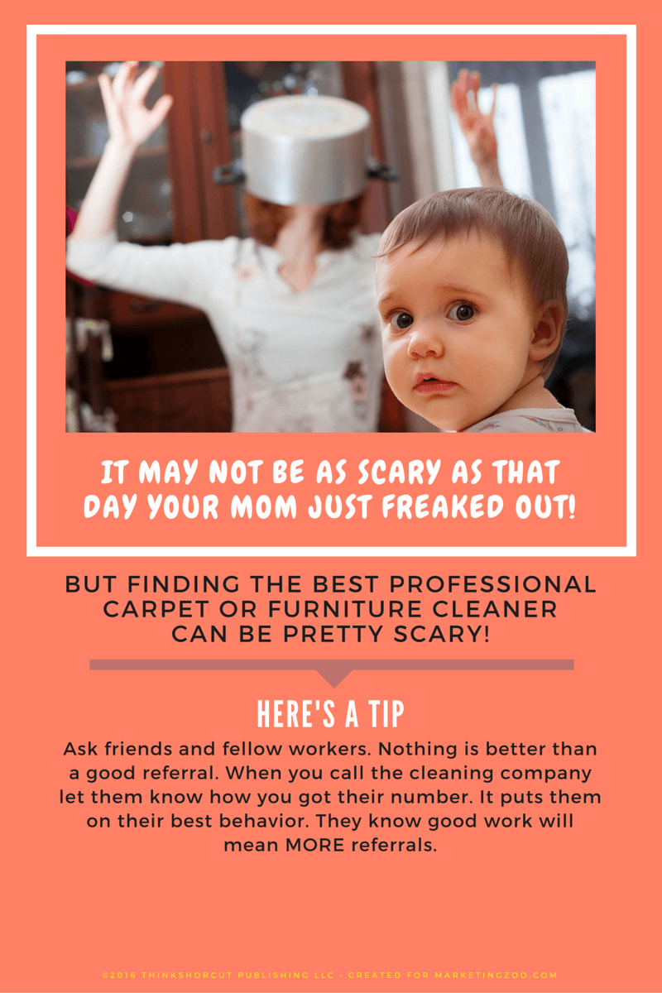
3 copy
Bed Bug Myths Debunked
There’s virtually nothing more disconcerting than an infestation of the bed bug in homes… and in the past few years, bed bugs have been making a comeback.
Yet just because you find a bed bug (or several) in your home doesn’t mean you aren’t keeping things clean.
Contrary to popular opinion, bed bugs aren’t picky. If they get into your home, they are looking for one thing: Food. That means, unfortunately, you are on the menu. And when they take a bite out of you, the emotional impact can be severe.
Bed bugs can be hard to find. Besides the tell-tale bites and itchy reactions, you have to go hunting to find their nesting ground. This can be in folds of blankets on your bed, in dresser drawers and in electrical outlets, just to mention a few. Bed bugs are sneaking critters.
The good news is that when you travel, and you encounter what you think are bed bugs, it’s not automatic that they will ride home with you. As a precaution, keep your suitcase on a table and avoid putting clothes in dressers. If you are careful, you can keep those critters at bay.
And when you arrive home, if there are any concerns about bed bugs hijacking in your suitcase, put your clothes in the washing machine and then in the dryer. This should take care of the pests.
Of course, when in doubt, do what’s safe: Call a pest control expert!
“Neatness and cleanliness is not a function of how rich or poor you are but that of mentality and principle.” ― Ikechukwu Izuakor, Great Reflections on Success
Short & Simple • © 2016 Thinkshortcut Publishing, LLC • Created by MarketingZoo.com

